Slide 1

DELIVERING FOR AMERICA
Our vision and ten-year plan to achieve service excellence and financial sustainability

Slide 2
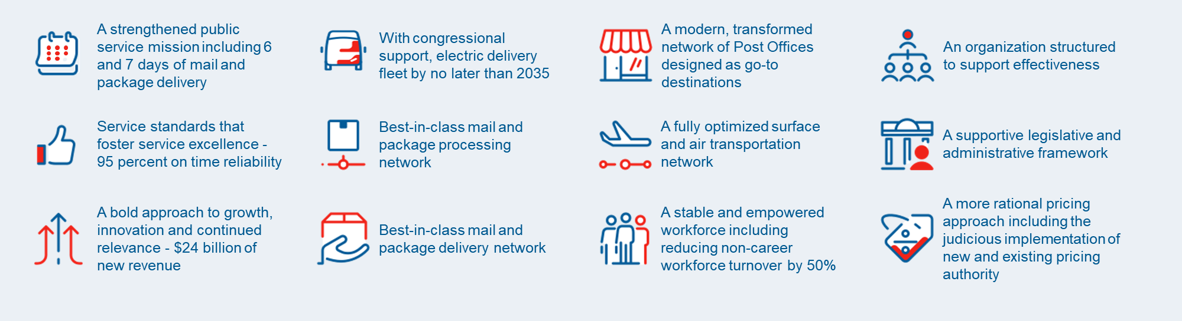

Ten-Year Plan Overview
Our Delivering for America (DFA) Plan launched on March 23, 2021, to transform the Postal Service from an organization in financial and operational crisis to one that is self-sustaining and high-performing.
The following set of transformational goals and key initiatives provide a roadmap to a more efficient, valuable, and relevant organization that will meet the evolving needs of the Nation and our customers for years to come.
A strengthened commitment to 6 and 7 days of mail and package delivery as part of our public service mission
A modernized vehicle fleet with an expanded electric opportunity based on a fiscally responsible rollout
A transformed network of Post Offices designed as go-to destinations
An organization structured to support effectiveness
Service standards that foster service excellence - 95% on-time reliability
A best-in-class integrated mail and package processing network
A fully integrated and optimized surface and air transportation network
A supportive legislative and administrative framework
A bold approach to growth, innovation and continued relevance - $24 billion in new revenue
A best-in-class integrated mail and package delivery network
A stable and empowered workforce including reduction of pre-career workforce turnover by 50%
A more rational pricing approach including the judicious implementation of new and existing pricing authorities
2

Slide 3
✓
Decreased our projected losses from $160 billion to $70 billion over 10 years
Noteworthy Accomplishments
Secured enactment of the Postal Service Reform Act into law to reduce expenses by $48 billion over 10 years
✓
✓
Packaged and delivered 600⁺ million COVID test kits to American households
Since last year, we have aggressively advanced core Delivering for America strategies. While much work remains to be done, the 10-year transformation plan has already demonstrated the path forward is achievable.
By realizing the totality of the plan, we will generate enough revenue to cover our costs, while providing the American people with the reliable service they expect and deserve.
✓
Converted over 102,287 pre-career employees¹ to career status
✓
Improved and stabilized service performance
Implemented new service standards for First-Class Mail, Periodicals, First Class Package Service, and Retail Ground/Parcel Select Ground
✓
[1] Conversations from October 1, 2020, to August 30, 2022

Slide 4
Improving and Stabilizing Service Performance
Service performance has improved and stabilized across all categories. Average time for delivery of a mailpiece across our network is 2.5 days, compared to 2.7 days (same period last year). These improvements are mostly due to the strategic diversification of volume traveling across the air network among more air carriers and reliable surface transportation providers in addition to implementing new standards for FCM, Periodicals, and FCPS.
THIRD-QUARTER SERVICE PERFORMANCE FOR April 1 THROUGH June 30 INCLUDED:
First-Class Mail
Marketing Mail
Periodicals
93.3%
94.6%
86.7%
Delivered 93.3% of FCM on time against the USPS service standard, an improvement of 5.4 percentage points from the second quarter.
Delivered 94.6% of Marketing Mail on time against the USPS service standard, an improvement of 2.4 percentage points from the second quarter.
Delivered 86.7% of Periodicals on time against the USPS service standard, an improvement of 5.2 percentage points from the second quarter.

Slide 5
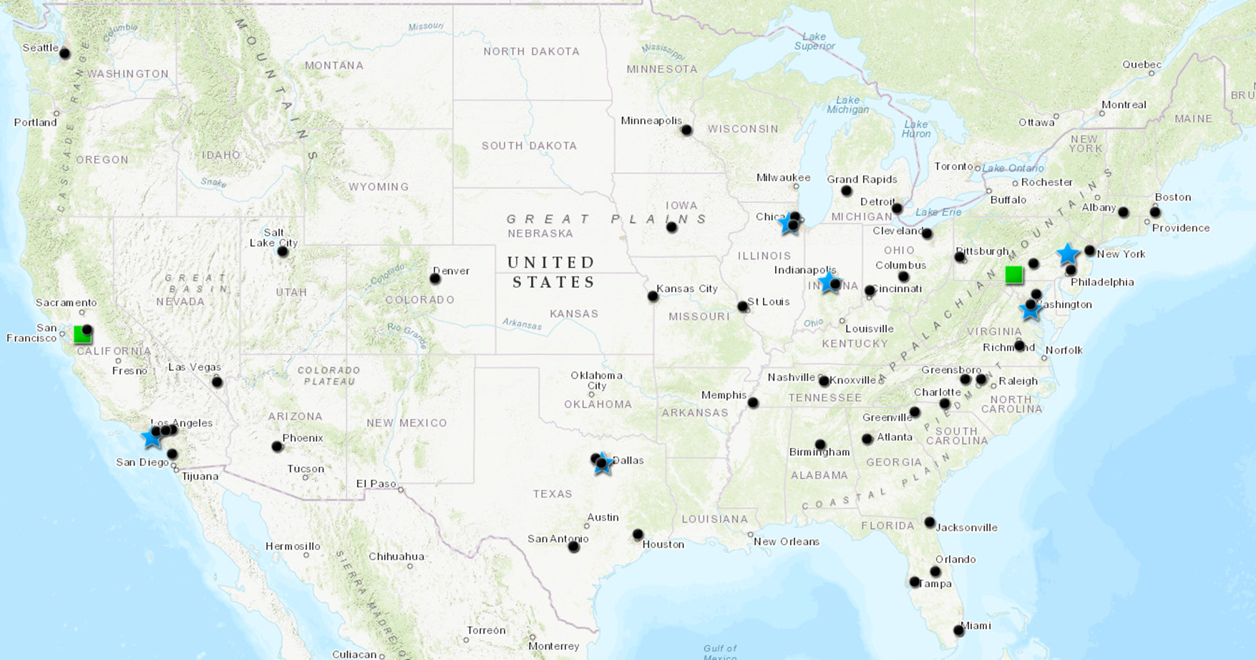

COVID Test Kits Program
by the numbers
Objective: Package, ship, and deliver millions of free rapid COVID test kits to households
600⁺ M
Test kits packaged and shipped
to 70 M American households across the country
150⁺ M
Orders delivered
to households across all states, Tribes, and territories – 4 test kits per order
1.2
Average days to deliver
a test kit package from shipment to delivery
Surface Transfer Center for distribution
Fulfillment Center for packing and labeling
Shipment origin
COVID Test Kits Program launched January of 2022

Slide 6
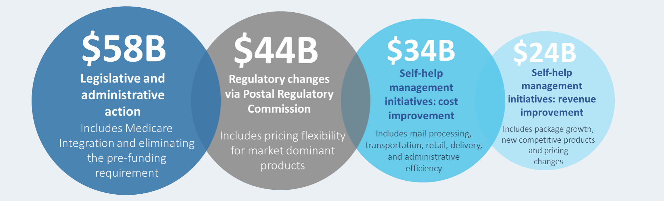
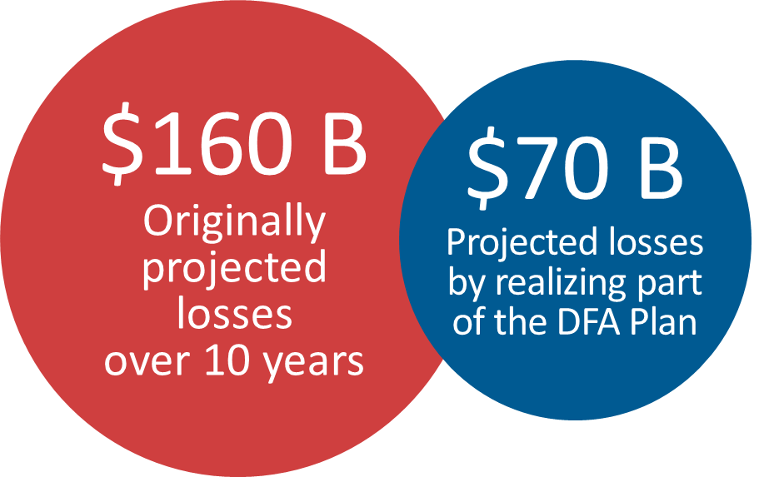
Decreasing Our 10-Year Projected Losses
From $160 Billion to $70 Billion by Realizing Parts of the DFA Plan
Revenue Generating Initiatives:
Increased package processing capability
Pricing changes
USPS Connect Regional and Returns
Modernizing platforms and applications
Sale of IPv4 address assets
Cost-Savings Initiatives:
Medicare integration & pre-funding mandate elimination
City package delivery and performance
Extra trips reduction
Aligning city office performance
Reduce dependency on air cargo network
6

Slide 7
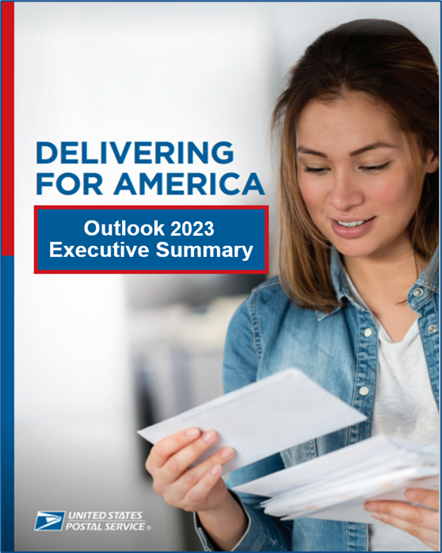
MOVING FORWARD
OVERVIEW OF APPROACH FOR FY23 & BEYOND
  Transforming Our Network
  Redefining Our Sales & Marketing Strategy
  Preparing for the Peak Holiday Season
  Investing in Our Future
  Stabilizing and Empowering Our Workforce

Slide 8
DELIVERING
FOR AMERICA
Transforming our Network

Slide 9
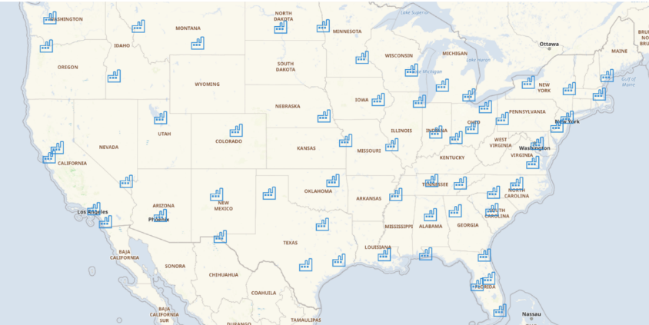
Creating an Integrated Mail and Package Network
Dependent Initiatives at Risk
Transportation Performance
Management Expectations
Improved Employee Experience/Relations/Turnover
Service Reliability
Financial Performance
Environmental Sustainability
Sales Growth
USPS Connect and
Delivery Related Services
Next Big Changes
Network Redesign
Delivery Unit Redesign
Operating Standards and Budgeting
Product Profiles

Slide 10
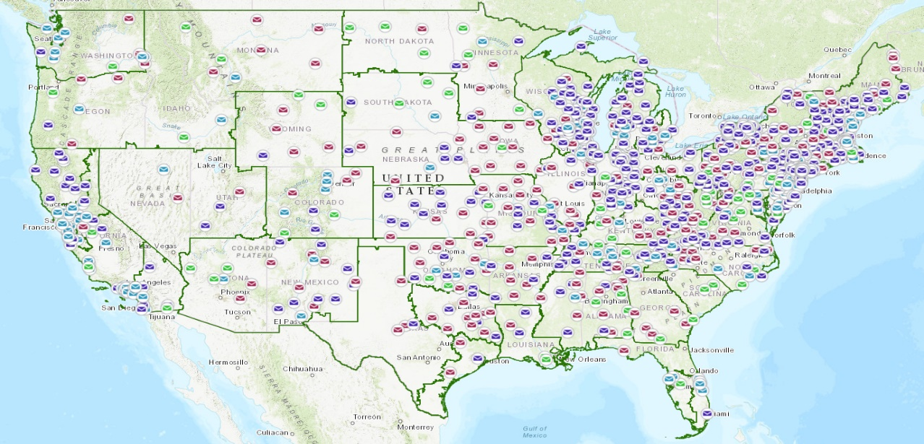
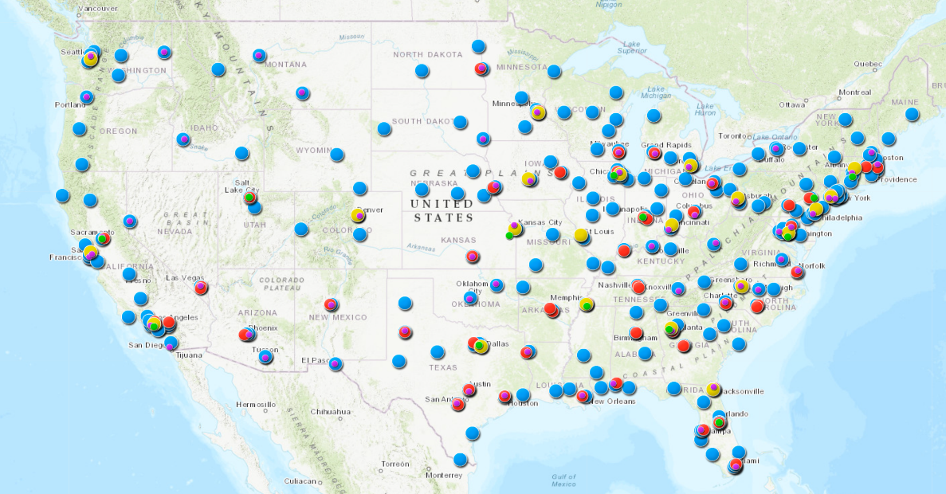
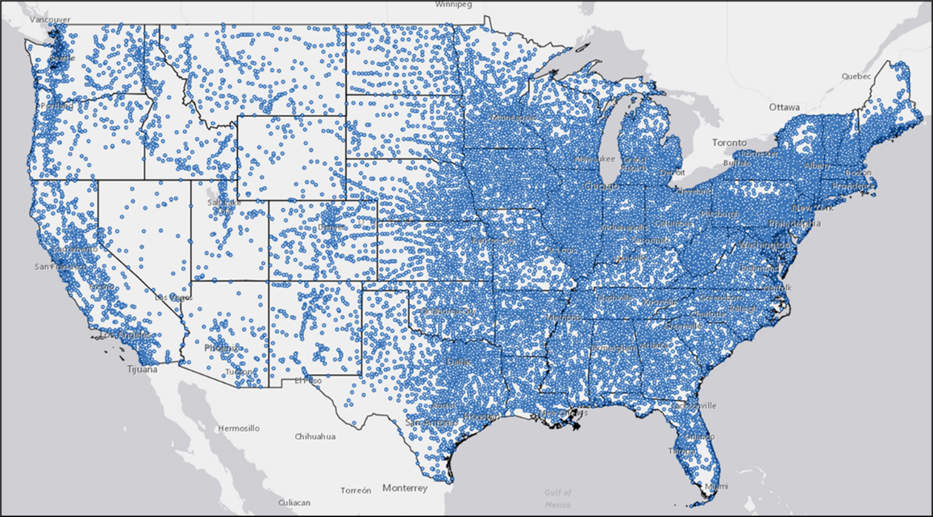





Current Infrastructure
1,088 Service Hubs
427 Middle Mile Facilities
19,000 Delivery Units
236 P&DC – Processing & Distribution Centers
21 NDC – National Distribution Centers
86 Annex or Parcel Support Annex (PSA)
13 STCs – Surface Transfer Centers
71 THS – Terminal Handling Service

Slide 11
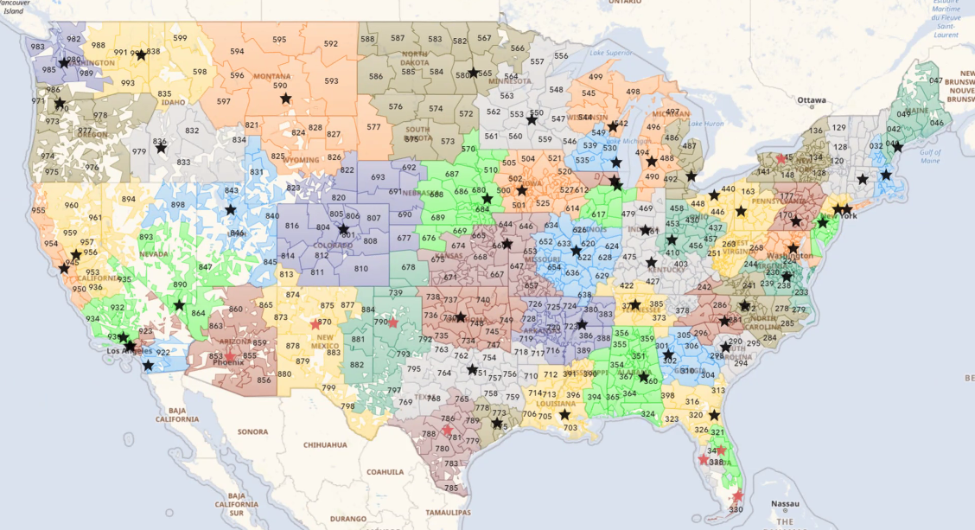
Best Fit Design: 60-65 Regional Processing and Distribution Locations (RPDC)

Slide 12
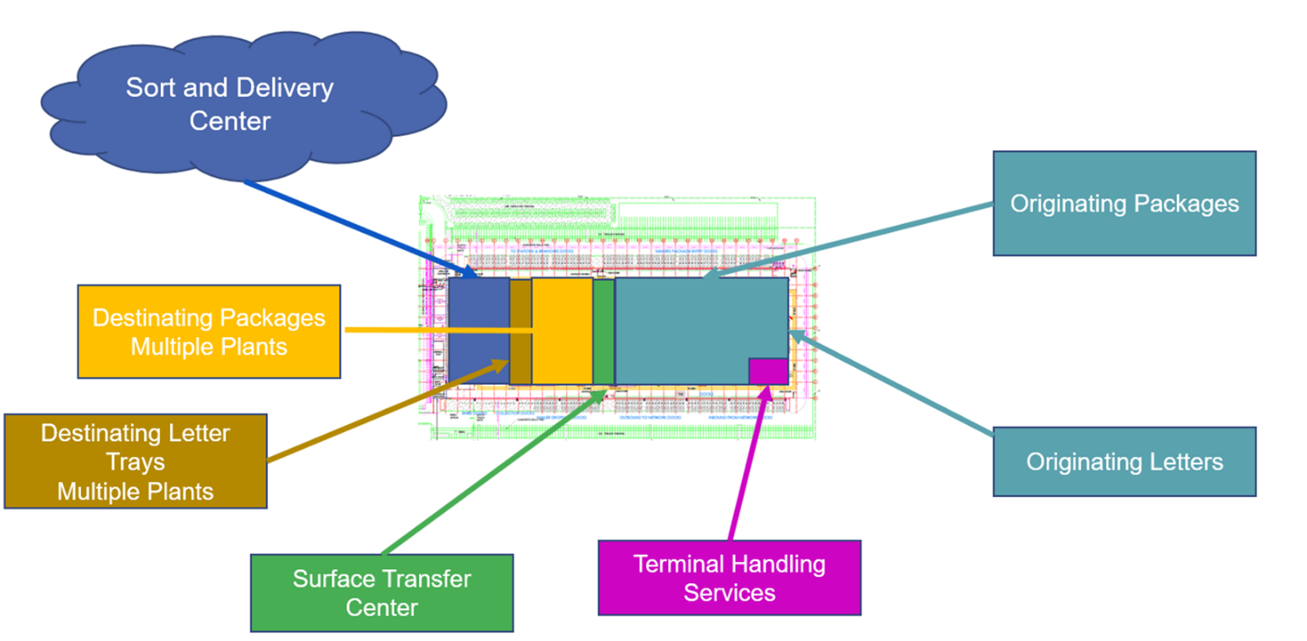
Regional Processing and Distribution Center (RPDC)
RPDCs will be designed to include the following:
Originating Letters: Trips out to the network will be dispatched from 1 location, increasing both tray and truck utilization, and eliminating the need to consolidate through downstream STCs
Originating Packages: Trips out to the network will be dispatched from 1 location, increasing volume, which in turn increases truck utilization and enables investment in higher powered sortation equipment
Destinating Packages: All network trips can be sent to 1 location, eliminating trips and necessary sorts at origin plant. Increases destinating entry reach for customers seeking 1–2-day package delivery
Destinating Letter Trays: All network trips can be sent to 1 location, eliminating trips and necessary sorts at origin
STC and THS: Work will be brought in-house to be completed by Postal employees
Sort and Delivery Center: 100% of package transportation to and from the delivery unit will be eliminated

Slide 13
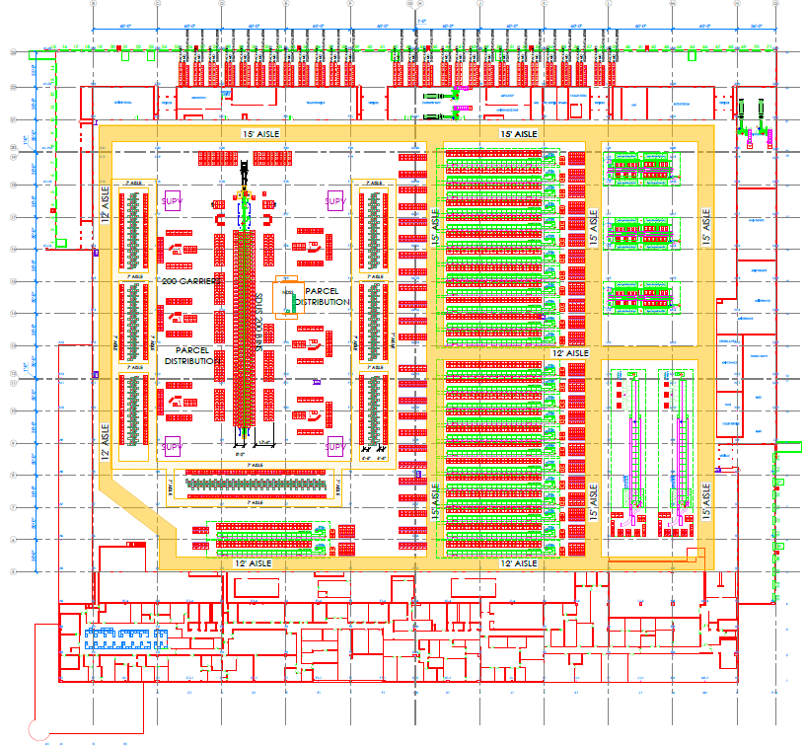
Local Processing Center (LPC)
LPCs will be designed to:
Perform the primary sort for destinating letters
Sort destinating letters into carrier walk sequence
Perform destinating flats processing
Create enough space to add a Sort and Delivery Center
  Since package processing is removed, every LPC should have enough space for an S&DC
Transport mail volume downstream to other Sort and Delivery Centers
Transport mail volume downstream to other Delivery Units

Slide 14
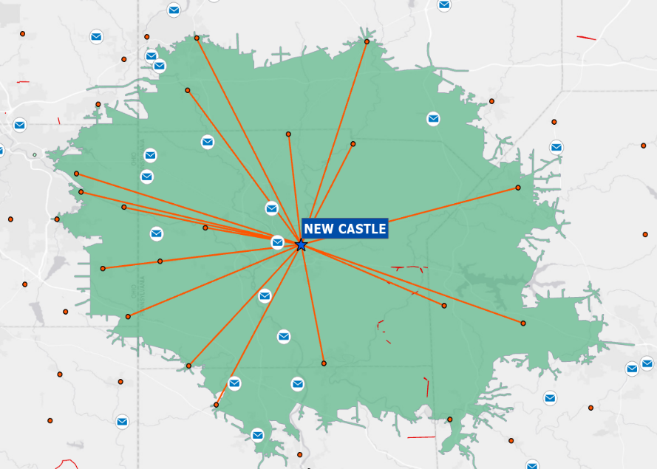

Sort & Delivery Center (S&DC) Concept
Optimize site locations to create larger delivery units as Sort & Delivery Centers (S&DCs)
Collapse carrier routes from smaller units into a S&DC
Retain PO Boxes and Retail in current locations
Provide S&DCs with volumes earlier; improve machines to process timely, efficiently
Optimize trips to/from the RPDCs/LPCs to S&DCs
S&DC

Slide 15
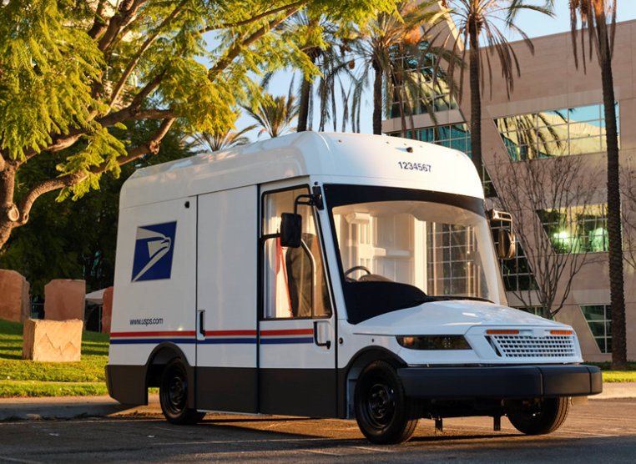
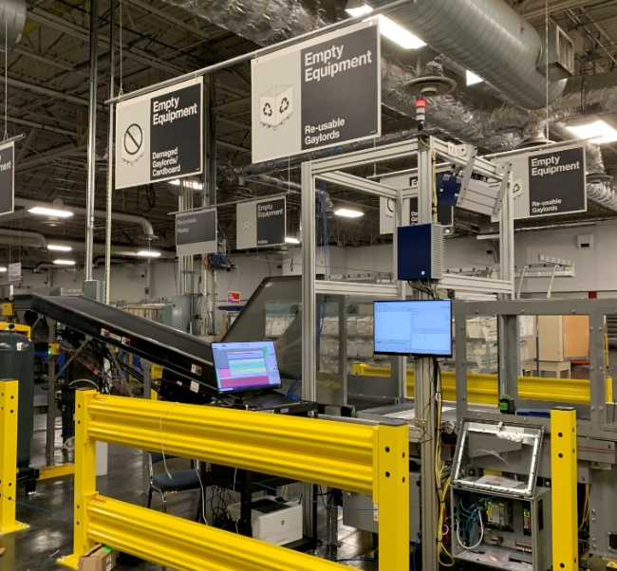
S&DC Benefits and Community Impact
Gain efficiencies in transportation and mail handling
Improve building and conditions for employees
  Better lighting, more floor space, larger docks
Implement modern equipment and technologies
  Less manual sorting, higher throughput equipment
Minimize destinating sorts required at upstream processing facility (RPDC/LPC)
  Reduces workload in processing operations
  Improves service performance
Improve customer service & resiliency
  More flexibility in route coverage
Enable vehicle electrification
  By creating longer routes
  Utilizing existing infrastructure
Create marketplace advantages
  Larger reach enabling additional opportunities for local commerce
  In vacated areas, we will offer space to businesses. We will provide direct access to our nationwide network

Slide 16
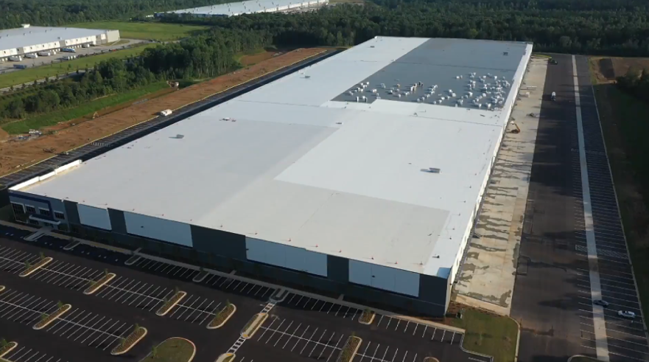
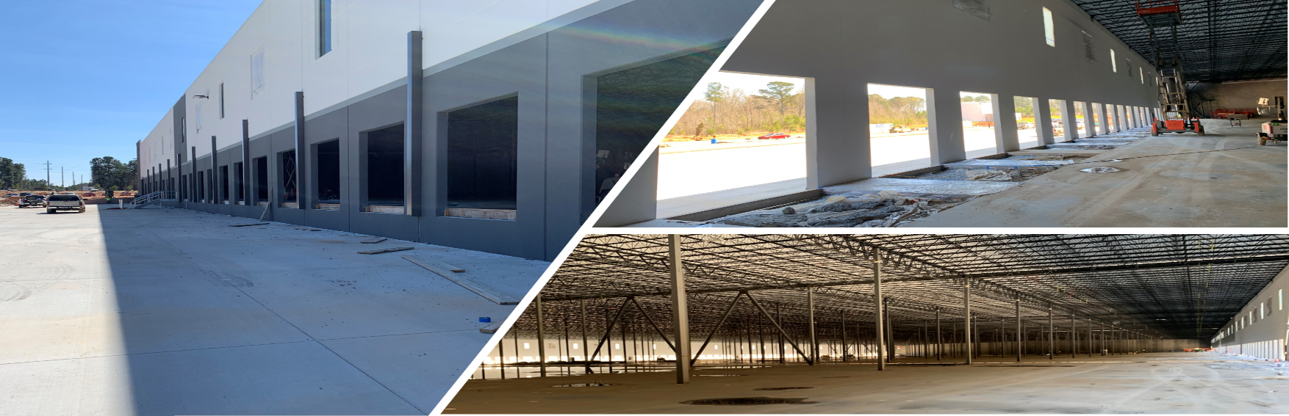
Atlanta RPDC
Brand new building
Better work conditions
Better lighting
More workroom floor space
Improved yard conditions and trailer staging
Larger docks
More employee parking
Higher throughput equipment

Slide 17
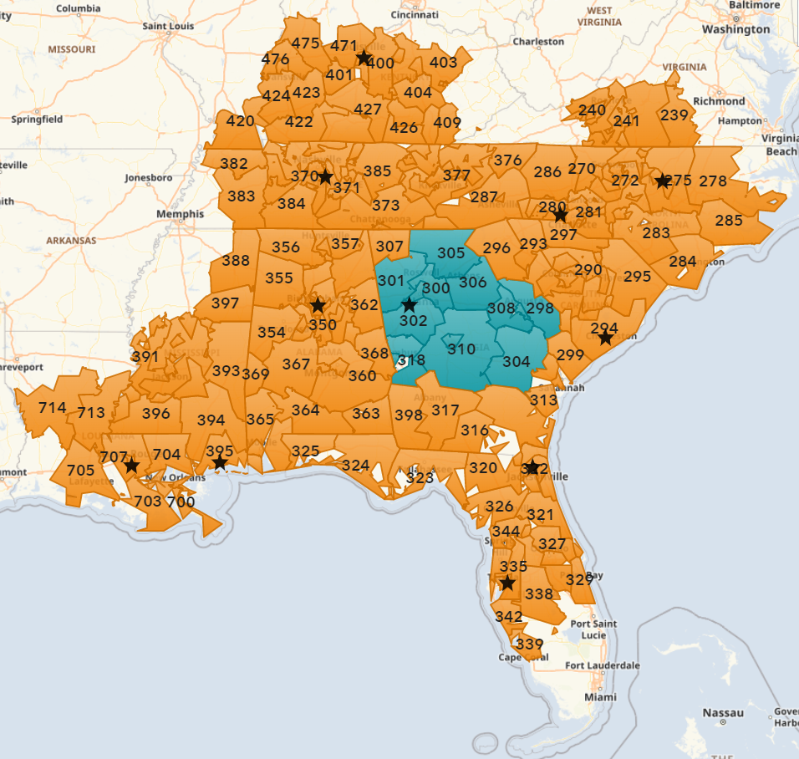
RPDC Benefits: Competitive Advantage
Regional Example:
Promote regional entry for customers seeking next day and two-day package delivery
RPDC: 1
Next Day Reach: 7M People
Two Day Reach: 55M People
Potential RPDC Location
Next-day Reach
Two-day Reach

Slide 18
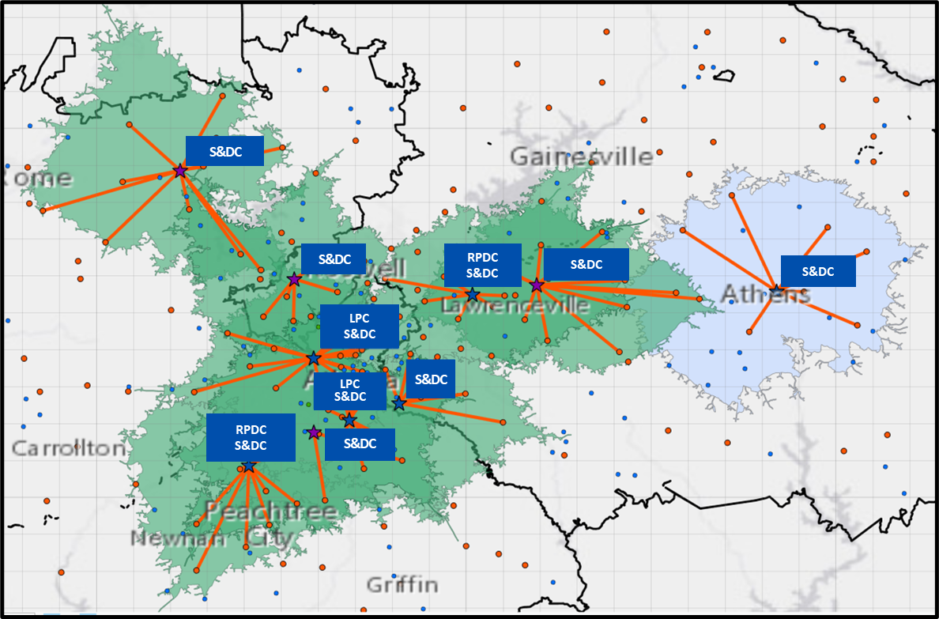
S&DC Benefits: Competitive Advantage
Local Example:
Less entry points, servicing more people
S&DCs: 10
Routes: 2,301
Delivery Points: 1.76M
Population Serviced: 4M
Key:
S&DC – Sort & Delivery Center
RPDC – Regional Processing and
Distribution Center
LPC – Local Processing Center

Slide 19
DELIVERING
FOR AMERICA
Sales & Marketing Approach

Slide 20


Strengthening the value of mail
Connect Local Mail offers expected same and next day delivery in select locations for sending urgent documents
Every Door Delivery Mail (EDDM) Rollback decreases the price of EDDM-Retail to pre-COVID levels to support rebounding of revenue and volume for the product and small businesses
Plus-One provides the option for customers to add a card to saturation marriage letter mailings
First-Class commercial large size postcard provides more space for messaging and other design elements while maintaining the delivery speed of First-Class mail
Promotions encourage marketers, printers, and mailers to try out new technology and print techniques driving higher engagement and responses increasing the return on investment
“Driving mail in local communities through products programs and enhancements to generate value and revenue”
20

Slide 21
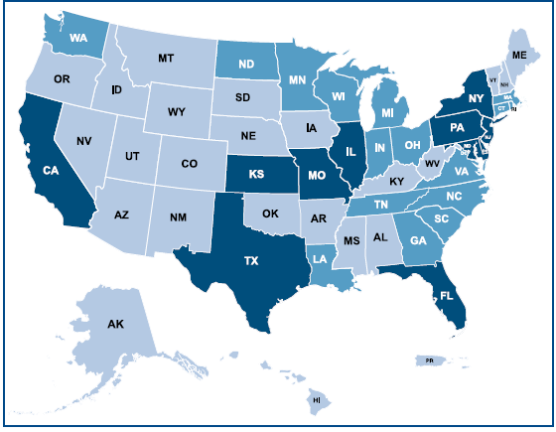
A bold approach
to growth,
USPS CONNECTTM
The USPS Connect™ Local program offers new, affordable package and document delivery options for small to mid-sized businesses. The program is currently available in 48 states and will be in all 50 by the end of September.
More than 8,120 customers have registered so far, and we are running a Connect Local Mail Market Test in conjunction with the rollout.
The USPS Connect™ Regional has garnered more than $800 million in revenue through increase package volumes by offering direct access for mid-to-large shippers. The program also launched its eCommerce platform for shipping integration.
The DFA Plan projects $24 billion in net revenue growth, and the USPS Connect program is slated to be one of the contributors of revenue and growth in addition to positioning us as the preferred delivery service provider.
Key:
Wave 1 – completed
Wave 2 – completed
Wave 3 – in progress
21

Slide 22
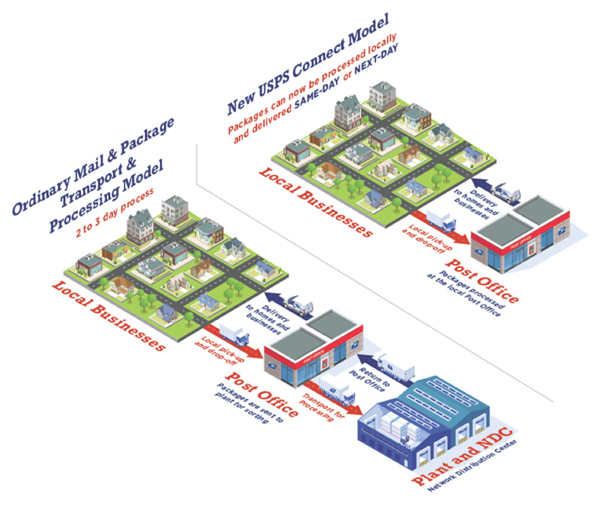
Why USPS Connect™ Local is good for your business.
Meet customer demand.
Provides new,
cost-effective ways
to meet customer demand for
fast delivery.
Fast delivery.
Offers expected same-day or next- day package and mail delivery.¹
Convenient pickup.
Provides free Package Pickup, available for next- day delivery.²
Cost savings.
Flat-rate shipping
and mailing supplies are available at no additional cost³ when you print and pay for postage via the Click-N-Ship® application.
Added value.
Qualified customers could be featured in our USPS® Shipping Local Directory on USPS.com.⁴
Participation in USPS Connect Local requires agreement to program terms and entry of packages and mail close to final destination. Same-day delivery is expected but not guaranteed and may not be available at all locations. Next-day delivery may be impacted by holidays and availability of Sunday delivery. When Sunday delivery is available, there is an additional fee for USPS Connect Local Shipping services. Sunday delivery is not available for USPS Connect Local Mail services. Additional restrictions may apply. Speak with your USPS® Representative for details.
For details on free Package Pickup, visit usps.com/pickup. On-demand pickup is available for a fee and is not available for the USPS Connect Local flat-rate mail service.
Free packaging is only available for Flat Rate boxes, bags, and envelopes.
Please visit usps.com/business/shipping-local-directory-criteria.htm for details and eligibility requirements.

Slide 23
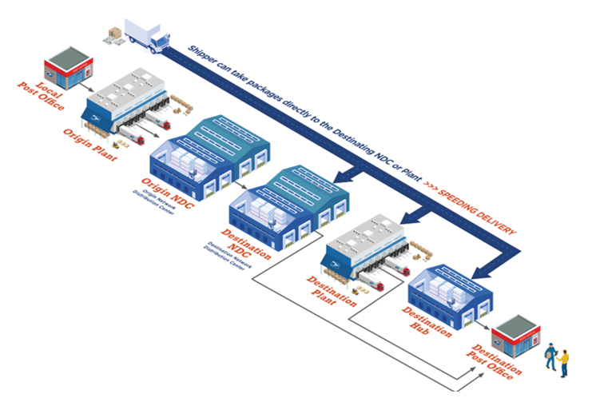
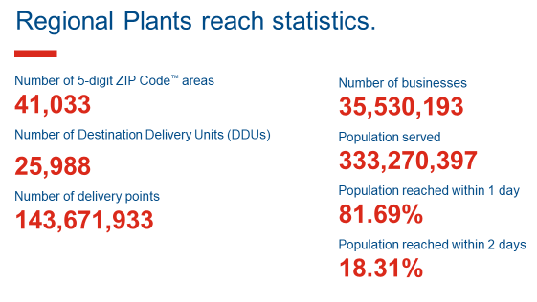

Why USPS Connect™ Regional is good for your business.
Reach more than 80% of the U.S. population by the next day through our network of regional plants nationwide.
Model

Slide 24

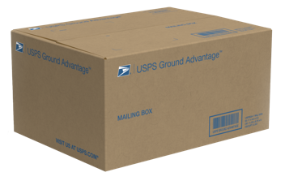
USPS Connect™ National – A powerful new shipping option
Introducing…..
USPS Ground Advantage™
Our new simple, affordable, and reliable ground product providing customers a range of options and great benefits built on our integrated mail and package network available as of July 9th.

Slide 25

USPS Connect™ National – A simplified solution for you and your customers
Three different products combined into one simplified solution
Retail Ground
Parcel Select Ground
USPS Ground Advantage™
First-Class Package Service®

Slide 26

USPS Connect™ National – The Advantage of USPS Ground AdvantageTM
Packages delivered in 2-5 business days across the continental United States.
USPS Ground Advantage™
Free package pickup service at home or in-office.
Business customers can use USPS Ground Advantage return service as a convenient option for customers who need to send items back.
$100 insurance included on USPS Ground Advantage and USPS Ground Advantage Return packages. Customers can purchase up to $5,000 in additional coverage.

Slide 27
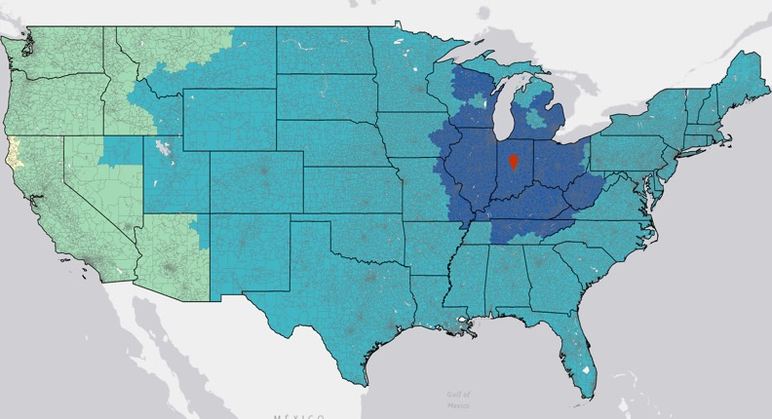
USPS Connect™ National – Reliable delivery within 2-5 days
SHIPPING FROM INDIANAPOLIS with USPS Ground Advantage™
Reach 80% of the country in 2-3 days
2 – Day Reach
3 – Day Reach
4 – Day Reach
5 – Day Reach
*Note — Service standard information pulled on 12/2022 and originating facility information pulled from TOPS on 2/2023
Original Facility
27

Slide 28
DELIVERING
FOR AMERICA
Holiday Season Preparations

Slide 29
Understanding 2020 Challenges
The 2020 holiday season demonstrated a need for change:
The result was a severely overcapacity Postal system with inadequate levels of resources - space, people, and equipment.
Changing consumer demand, accelerated by the pandemic, yielded historic package volumes.
Those volumes overwhelmed our network, a network that was originally built for high volumes of letters and flats, and one that has been underinvested in across the last decade.

Slide 30

Capacity planning for holiday season success
We began planning for this upcoming holiday season earlier. We have accelerated key processing, logistics, and delivery investments to meet customers' evolving mail and package needs. Our proactive measures not only correspond to challenges faced in 2020 but also align to our Delivering for America plan. The organization is executing on strategies to pull together people, technology, transportation, equipment, and facilities into a well-integrated and streamlined mail and package network.
A nationwide effort to hire new employees including over 28,000 seasonal employees. We also converted more than 100,000 non-career employees into career status since January 2021.
Leasing additional square feet in facility annexes to prevent bottlenecks by creating more space for package processing.
Installing 250 new package sorting machines to process higher volumes – 137 are being installed this year.
Adapting our transportation and logistics processes to handle the high mail and package volumes we expect to deliver during peak.

Slide 31
DELIVERING
FOR AMERICA
Investments for Our Future

Slide 32
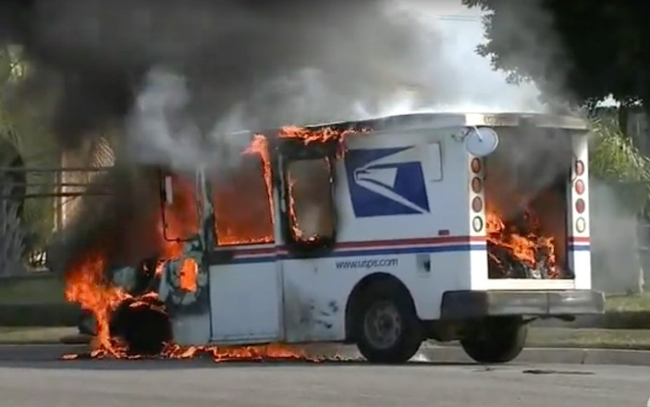
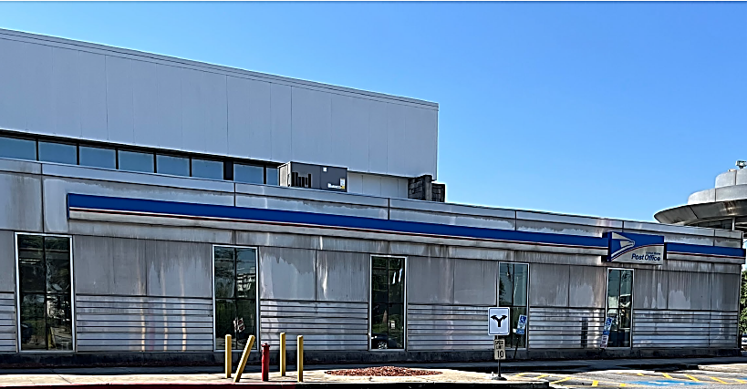
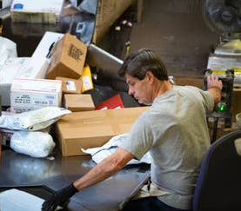
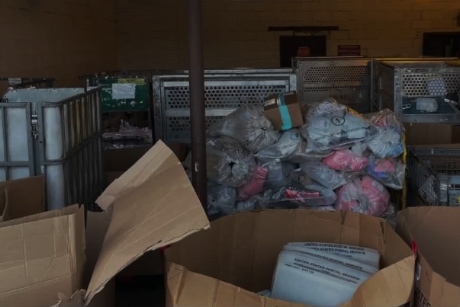
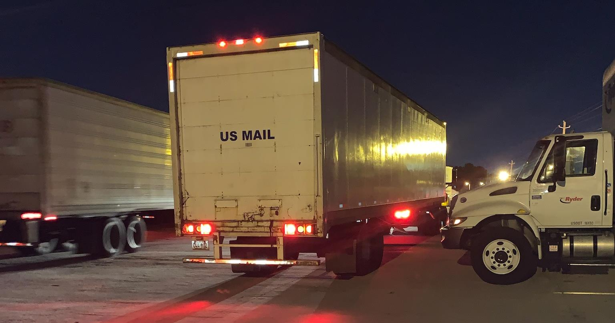
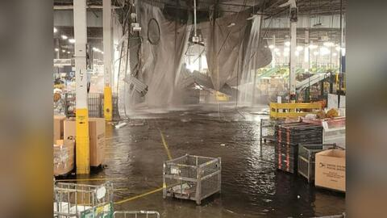
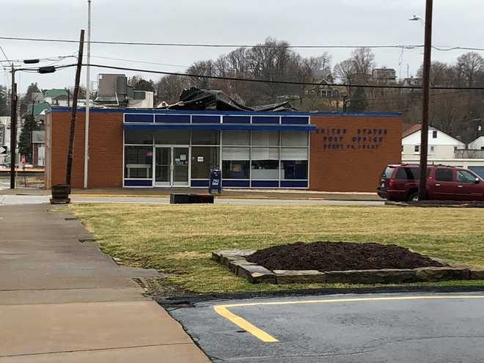
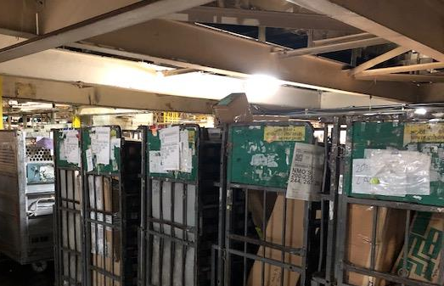
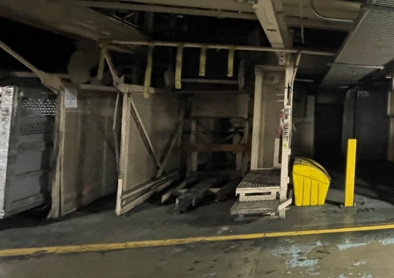
Poor Conditions after Decades of Underinvestment
Vehicles catch on fire
Poor facades
Lack of equipment
Poor lighting
A roof collapses
Not enough space
Old dark facilities
Roofs need replacing
Lack of parking leads to congestion
32

Slide 33

$18.0 B
New Delivery Vehicles
to replace our aging fleet
DFA Investments
Network Redesign
to replace & upgrade facilities, streamline operations, and reduce transportation
by the numbers
$8.6 B
Technology Modernization
to upgrade software systems, improve computing performance, and invest in e-commerce tech
$4.2 B
$3.8 B
Greater Package Capacity
expansion by acquiring new equipment and modernizing distribution centers
The DFA Plan commits to $40 billion in investments over 10 years with a deliberate, strategic approach to updating or replacing our facilities, equipment, and technologies that will enable us to serve customers long into the future.
Only through these investments will we achieve financial sustainability, grow our business, and deliver service excellence over the next decade.
$3.1 B
Retail & Delivery Redesign
to expand and replace space-deficient Delivery Units to support the future delivery model
$2.2 B
Operational Tech & Support
in enterprise analytics, real-time tracking technology & data collection

Slide 34
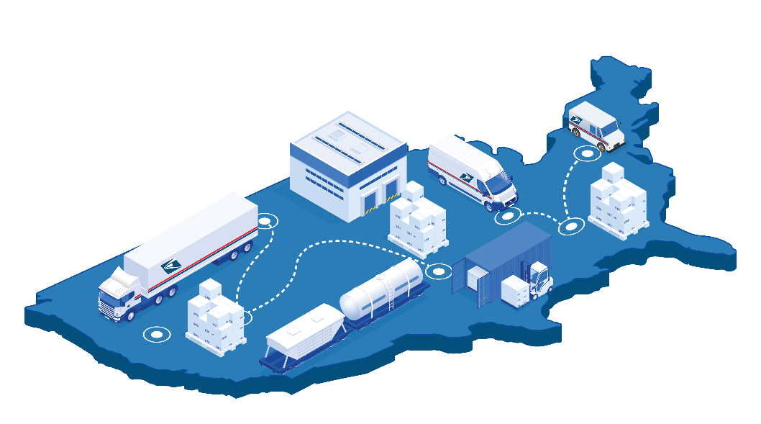
$8.6 Billion for a Network Redesign
As part of a major effort to logically sequence mail and package flows, we plan to:
Upgrade facilities by replacing or repurposing old, deficient facilities
Build an Integrated Mail & Package Network to Handle Increased Demand
Standardize plant operations
Redesigning and rebalancing our processing network is the most efficient and enduring way to improve reliability and predictability for our customers.
We will integrate mail and package movement along with processing functions in a logical sequence. We will simplify our network and identify the right locations that will process our products in a complete manner. These efforts will result in increased processing capacities and productivities.
Set an achievable operating plan
Organize transportation and operations for a logical flow of mail and packages
Reduce transportation nationally and locally
34

Slide 35
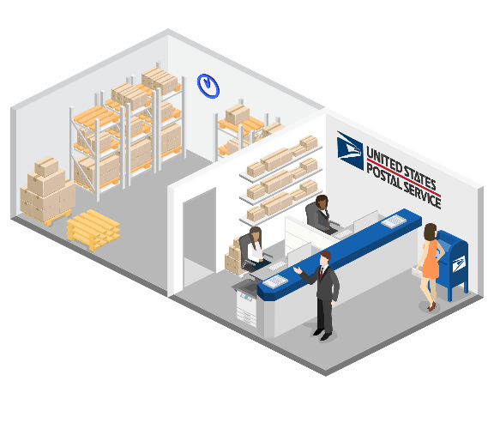
$3.1 Billion for Retail & Delivery Redesign
Expand and Replace Space-Deficient Delivery Units to Support the Future Delivery Model and Grow Our Reach
We will improve our delivery footprint to align with emerging market demand. By aggregating more Delivery Units (DUs) into larger facilities in the right locations, we will grow our same-day and next-day reach by providing businesses with greater access to direct entry of their shipments. To improve our capacity in large DUs, we will add more automated package sorting equipment there by optimizing our efficiencies, resiliency, and customer service offering.
Specific Retail & Delivery Investment Initiatives:
Combine delivery units to expand reach
Upgrade facilities by replacing or repurposing old, deficient facilities
Procure and install more autonomous package sortation equipment
Improve building and operating conditions for employees
Remarket available space created to grow our revenue
Enable vehicle electrification through a concurrent rollout
35

Slide 36
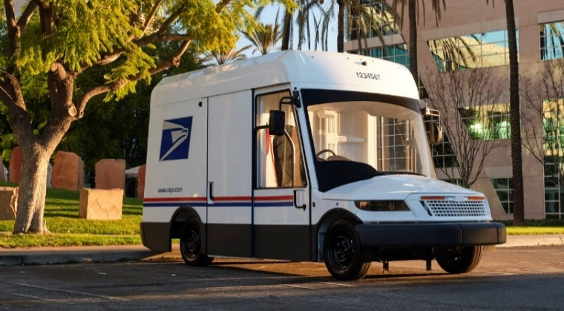
$18 Billion for New Delivery Vehicles
We aim to replace nearly 200,000 of our 233,000 vehicles over the next 10 years. It’s one of the most dramatic modernizations of our fleet in more than three decades.
New vehicles will provide carriers with more safety and comfort, while equipping them with modern features to increase delivery efficiency.
Recently, we announced an expanded electric opportunity to reflect our network changes, route optimization, and financial improvements.
84,500 NGDV and COTS have been ordered. At least 40% of these will be electric.
We will continue to evaluate the vehicle mix and purchase capability in shorter intervals as technology evolves and both our financial and operational trajectories improve.
Flexibility allows for future increases in the number of electric vehicles with additional funding from internal or other external sources, and as supply continues to improve.
We are committed to the fiscally responsible roll-out of electric-powered vehicles for our fleet.
The DFA Plan commits to investing $18 billion in a new delivery fleet over the next 10 years to replace America’s largest and oldest one. Our fleet travels more than 1.34 billion miles annually across a multitude of terrains while experiencing a variety of package volumes, distances, weather patterns, temperatures, and traffic densities.
Since not one model would fulfill the spectrum of demanding needs that our routes have, we plan to leverage not only Next Generation Delivery Vehicles (NGDVs) but also several commercial-off-the-shelf (COTS) options as part of the acquisition strategy. This allows us to be agile in responding to a rapidly changing automotive industry while balancing our evolving needs during a network redesign. Our pinpointed approach matches the exact vehicle use-case to each intended delivery route.
36

Slide 37
DELIVERING
FOR AMERICA
A Stable & Empowered Workforce

Slide 38






Our People Are Our Greatest Asset
Our success depends on investing in the future of our workforce. We strive to be an “employer of choice” that hires, develops, and retains the most capable and diverse set of employees. Our plan focuses heavily on improving our collaboration and engagement within the workplace and strengthening the employee experience through the following measures:
Conversions: from pre-career employees to career status
Front-line Supervisor Empowerment: new training program, better tools, and more resources
Workforce Development: defined career paths and training tracks, internal job fairs, and external hiring efforts
Engaged, Collaborative Leaders: installing a culture of organizational focus, transparency, and accountability
Building a Stable and Empowered Workforce
Executive Diversity Council: building a diverse pipeline of talented candidates
38

Slide 39
Positioning us to become
A high-performing organization.
A better approach to
Delivering for America.
“We will be a vibrant and thriving organization for decades to come that will provide the American people with the high-quality service they expect and deserve.”
These strategies take a deliberate and strategic approach to self-sustaining and high performing that will enable us to better serve our customers, long into the future.
As a high-performing organization, we will hire, develop, and retain the most capable and diverse set of employees. In turn, we will offer better customer service and operational performance as we continue offering affordable delivery to more than 163 million addresses across the country, six and seven days a week.
39

Slide 40
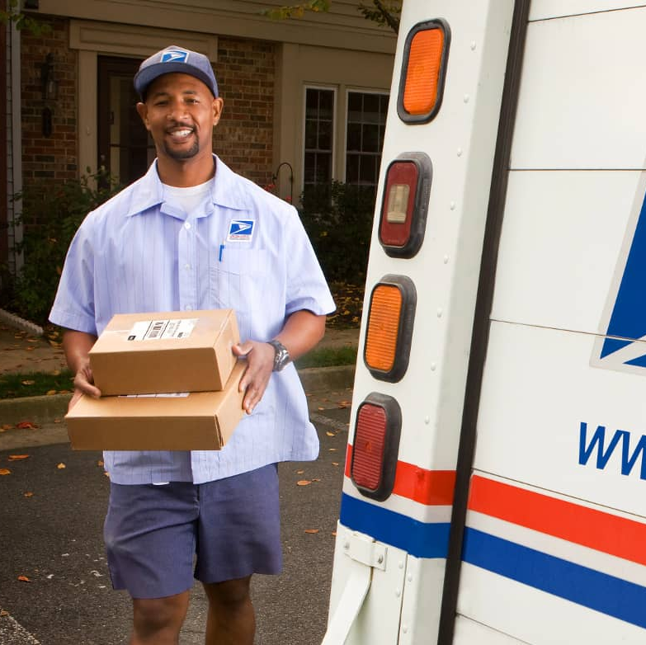

Benefits from the DFA Plan Will Lead to…
Improved service performance
Better facility conditions
Improved employee morale and lower turnover, long-term
Reduced transportation costs
A smaller carbon footprint through fewer trips and electric vehicles
Easier standardization and operations management through centralization
More local commerce opportunities through great delivery reach and higher yields

Slide 41
Our path forward
Our Plan provides an important path forward for an organization in crisis—and positions us to successfully meet the evolving mailing and shipping needs of the nation.

