Slide 1
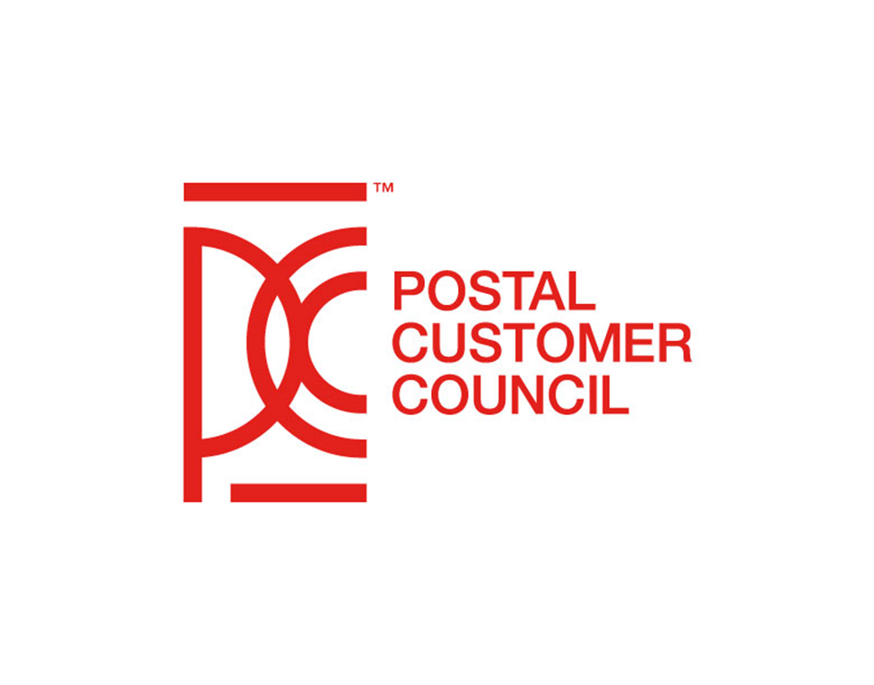
SEPTEMBER 2022

Slide 2

THE ENDURING VALUE OF MAIL
We must consider mail's value in the context of how people consume information in a digitally driven world, while recognizing that it offers unique benefits to businesses and consumers.
3X BETTER RESPONSE RATE
FOR DIRECT MAIL
3.5%
PROJECTED INCREASE
IN DIRECT MAIL MARKETING SPENDING
75%
61% OF ALL CONSUMERS
FEEL POSITIVE ABOUT DIRECT MAIL
OF CONSUMERS
MORE PERSONALIZED | ENJOY OPENING MAIL
HAVE DIGITAL FATIGUE
66%
ENGAGED WITH / ACTED ON MESSAGE
36%
MADE A PURCHASE
BECAUSE OF DIRECT MAIL:
1. SG360's 2021 Future of Direct Mail report
2. SG360's 2022 Future of Direct Mail presentation, 2022 National Postal Forum
3. Winterberry Group's 2022 Outlook for Advertising, Marketing and Data report
Notes:
Before we look at how the USPS Product Management team works to strengthen the value of mail, it is worth considering what it is that makes mail valuable.
Consider the fact that we consume so much of our content digitally these days, across a wide range of channels—social media, websites, apps, streaming services, and many others.
What Winterberry Group's 2022 Outlook for Advertising, Marketing and Data found is that consumers are demanding quality content at scale across all those channels. In today's "always on" marketing landscape, brands have adjusted to these trends by focusing more on digital experiences and personalization.
At the same time, in a world where digital fatigue has set in for 75% of consumers, mail's physical properties offer a refreshing, engaging alternative.
Sources:
3X better response rate for direct mail: SG360's 2021 Future of Direct Mail report
61% of consumers feel positive about direct mail – more personalized / enjoy opening mail: SG360's 2022 Future of Direct Mail presentation at NPF
75% of consumers have digital fatigue: SG360's 2022 Future of Direct Mail presentation at NPF
3.5% projected increase in direct mail marketing spending: Winterberry Group's 2022 Outlook for Advertising, Marketing and Data report
Because of direct mail: 66% engaged with / acted on it; 36% made a purchase: SG360's 2022 Future of Direct Mail presentation at NPF 2022

Slide 3
MAIL’S VALUE TO THE NEXT GENERATION
Compared to older generations in 2022, Gen Z (18-25) and Millennials (25-39):
Reported the highest levels of digital fatigue.
In 2021,
77%
Gen Z
and
Millennials
Showed the strongest engagement among consumers who engage with direct mail.
Indicated positive feelings about direct mail, compared to
Are more than 2X as likely to apply for financial and insurance products upon receiving direct mail.
71%
55%
1. SG360's 2021 Future of Direct Mail report
2. SG360's 2022 Future of Direct Mail presentation, 2022 National Postal Forum
Gen X
Baby Boomers
Notes:
Surveys show that all generations like direct mail, as long as it's useful and relevant to them. Interestingly, this is especially true for Gen Z and Millennials.
As digitally literate as they are, younger generations are actually engaging with the marketing mail they receive more than their counterparts over 56 years old.
Consider that 77% of Gen Z and Millennial respondents in a 2021 SG360 survey indicated feeling positive about direct mail, compared to 71% for Gen X and 55% for Baby Boomers.
SG360's 2022 findings reinforced this trend, with Gen Z and Millennial respondents showing high levels of engagement with direct mail.
Despite being digital "natives," Gen Z and Millennials respond strongly to physical stimuli, partially due to novelty (e.g., comeback of vinyl records and increased sale of print books).

Slide 4


Where paper meets paperless
COVID-19 accelerated the transition from print to digital communications…
…but also caused consumers to rethink communications preferences.
85%
OF
CONSUMERS
71% of marketers rate the effectiveness of digital tools supporting direct mail as:
prefer a blend of digital and physical marketing channels.
Top omnichannel tools supporting direct mail marketing:
  Email
  SMS/text
  Streaming audio/video
1. SG360's 2022 Future of Direct Mail presentation, 2022 National Postal Forum
Notes:
The COVID-19 pandemic may seemingly have changed the way we communicate. But the data we have gathered paints a picture that does not discount the power of traditional communication. With a world inundated by screens, it is important to communicate with our customers in a variety of ways.
Mail is particularly valuable to consumers and businesses when it is accessible across channels.
Today's consumer prefers a blend of digital and physical marketing channels, and marketers have indicated success in using digital tools to support direct mail.
Sources:
Source: SG360's 2022 Future of Direct Mail presentation, 2022 National Postal Forum

Slide 5










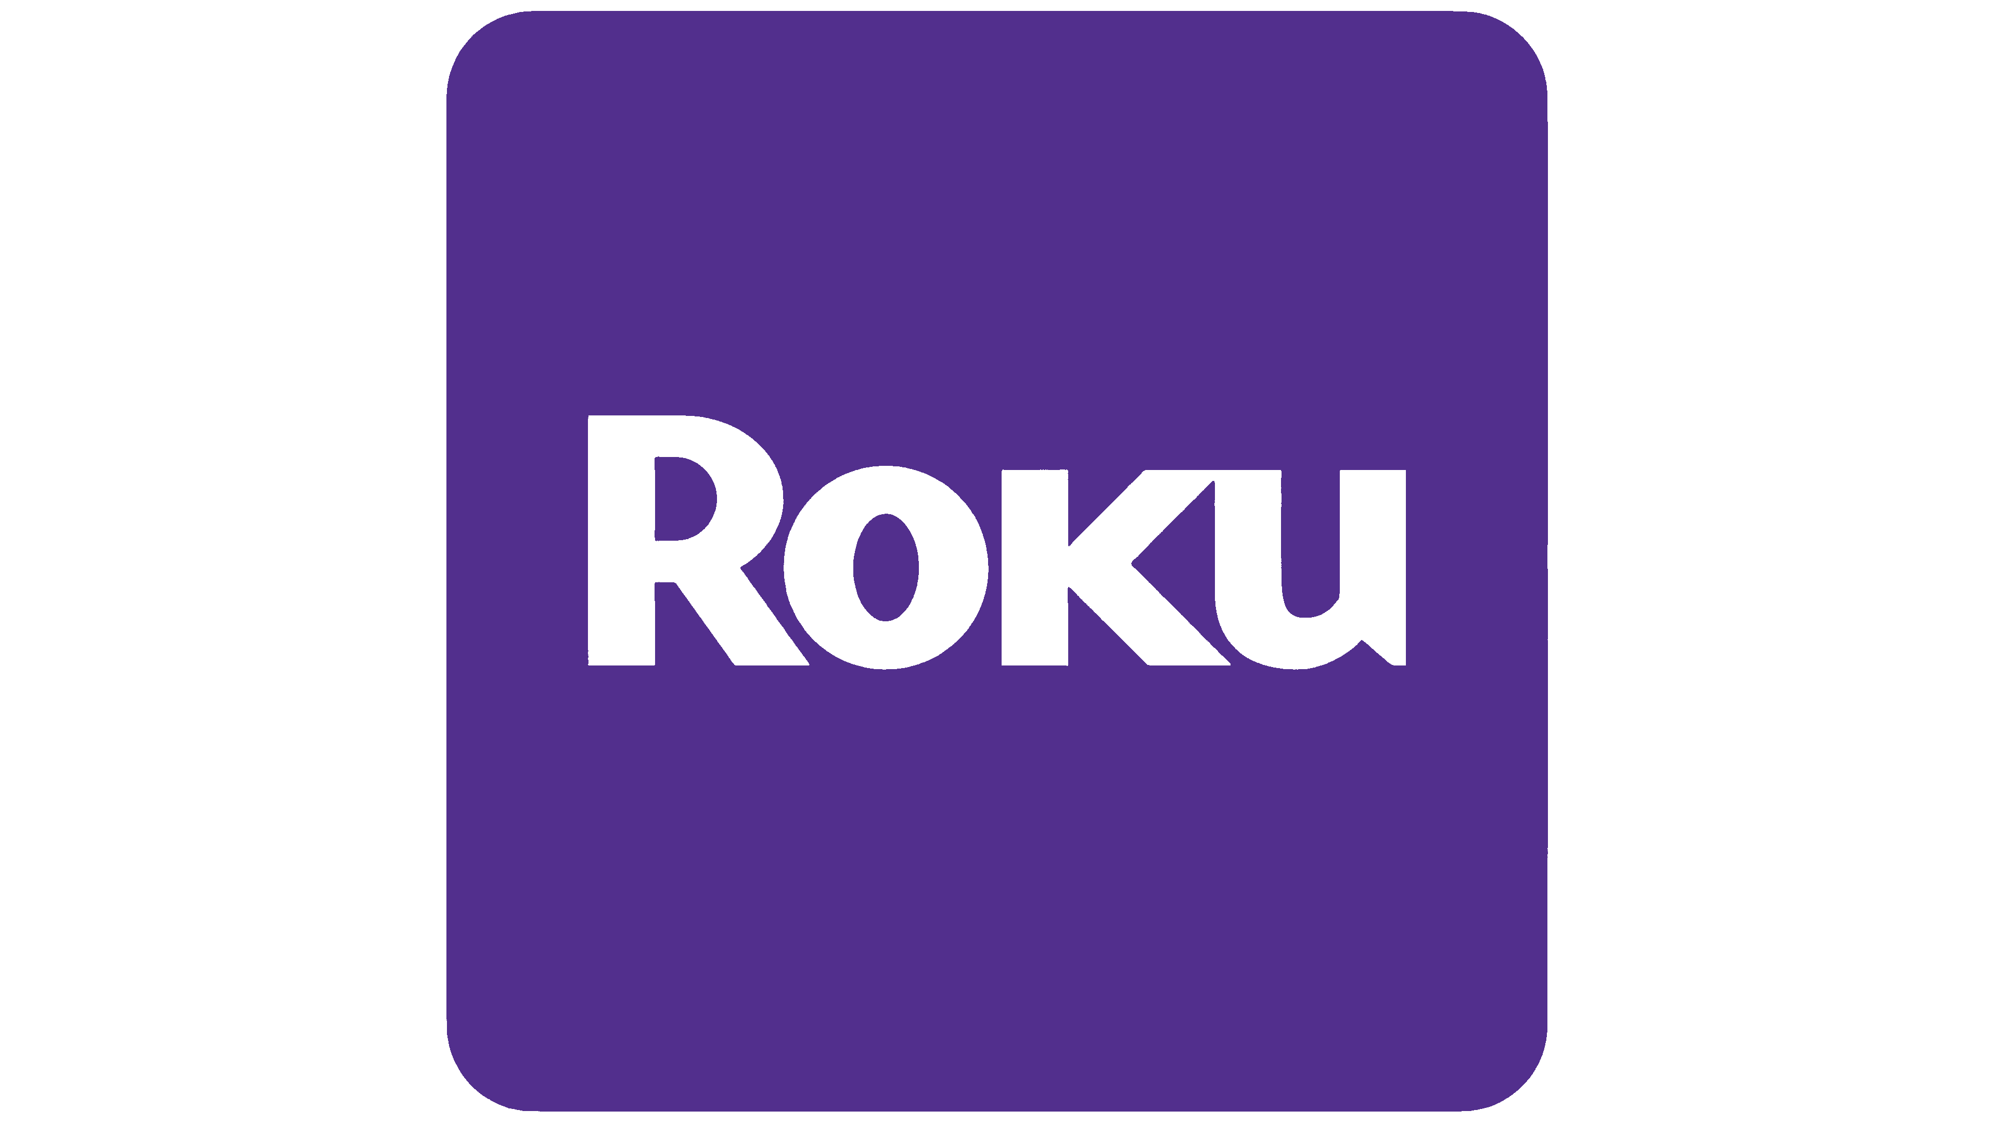


Top Trends in 2022 and Beyond…
Human Connection
User-Generated
Meta
Connected TV
The social media giant is jumping ahead of the game with their advances in data mining and virtual reality.
Personalized connections are crucial in our post-pandemic world as people begin the return to “normal”.
Brands are relying more and more on UGC and guerilla marketing strategies.
Customers are becoming more comfortable with meaningful, targeted ads through CTV platforms.
Notes:
Meta – as you know, was doing business as Facebook and owns these other iconic digital platforms as well.
CTV or Connected TV is a device that connects to – or is embedded in a television, flat screens really, to support video content streaming such as Xbox, PlayStation, Roku, Amazon Fire TV, Apple TV and others. The Winterbery Group is estimating a 32.3% increase in spend for 2022 while at the same time is predicting an increase of 23.1% for digital video.
Human Connection – well, here we are at this PCC Event! How many of you were waiting to see your friends and collogues again? This beats a Zoom call any day.
User-Generated Content – I guess we can all be guilty of this especially when we buy a new car, a boat or even a house. Anytime when any of those events occur you can be sure someone is posting it on FB, Instagram, TikTok or just pick your favorite site to brag and show off your new bling.

Slide 6

Staying Competitive With Marketing Mail
Features.
Notes:
Marketing Mail - today more than ever before it is important to diversify our communication strategy to cut through the digital clutter. We have several programs that help businesses to stay competitive and get the most out of their direct mail campaigns.
Today I am going to share some of these programs.

Slide 7
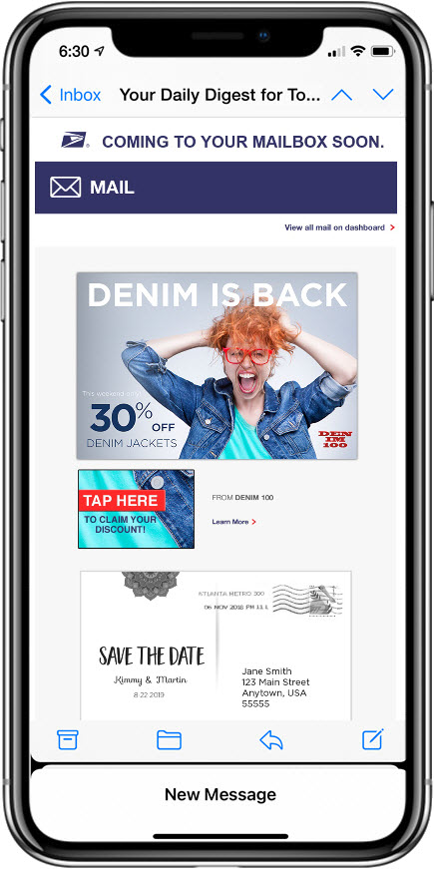


Informed Delivery enhances the value of physical mail by adding a digital component and interactive content
Informed Delivery users receive scanned images of the exterior of incoming letter-sized mailpieces (processed through automated equipment) and tracking data for packages.
Images and tracking are available via email notification, online dashboard, or USPS mobile app
If a shipper or mailer participates in Informed Delivery, supplemental content, referred to as interactive campaigns, will be shown to the receiving customer.
Interactive campaigns include custom images and a URL that directs the user to a digital experience.
Notes:
Informed Delivery - One of our flagship programs, Many of you may already be an active user and can see the benefits for yourself as a consumer. The USPS is continuously making strides to improve the platform to make it easier for marketers to reach their customers and for customers to take advantage of the offers.

Slide 8
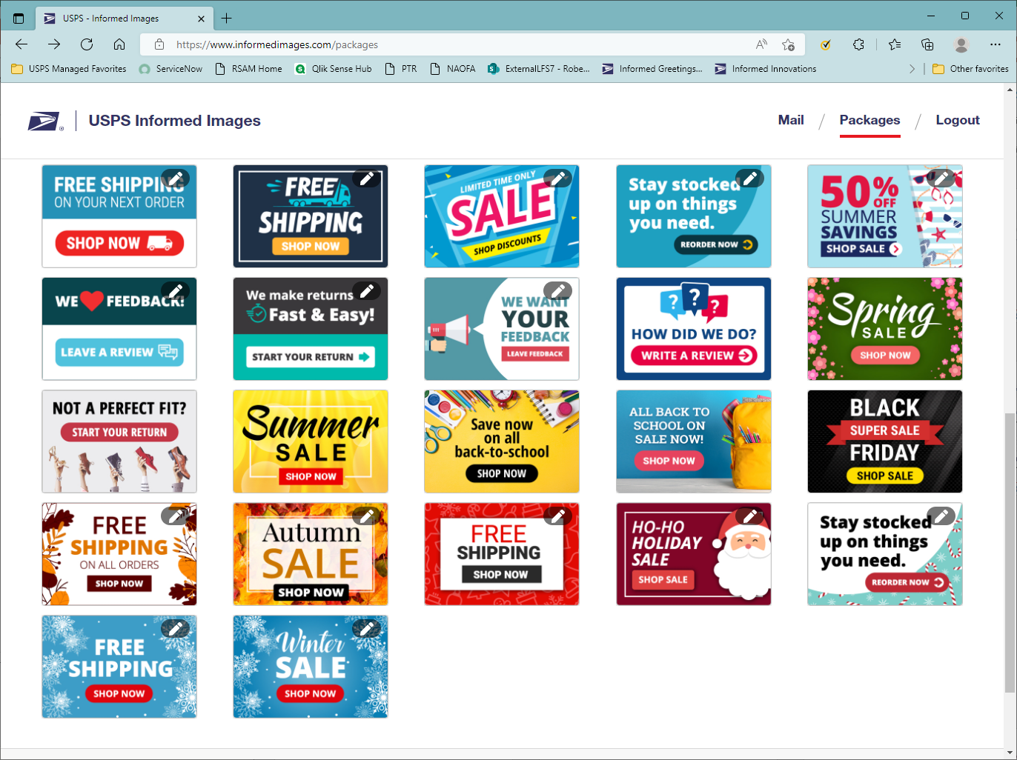
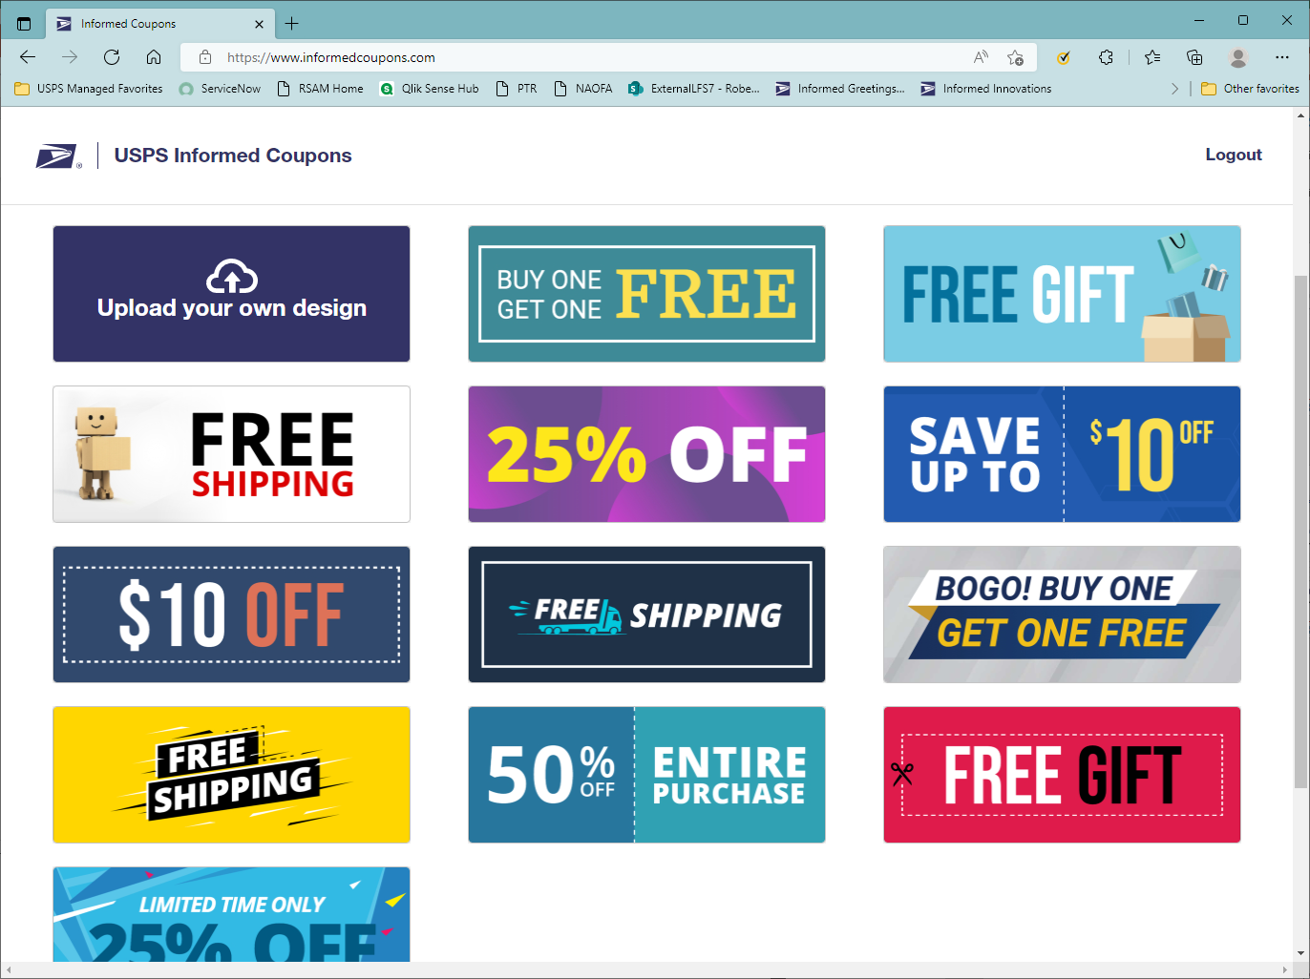
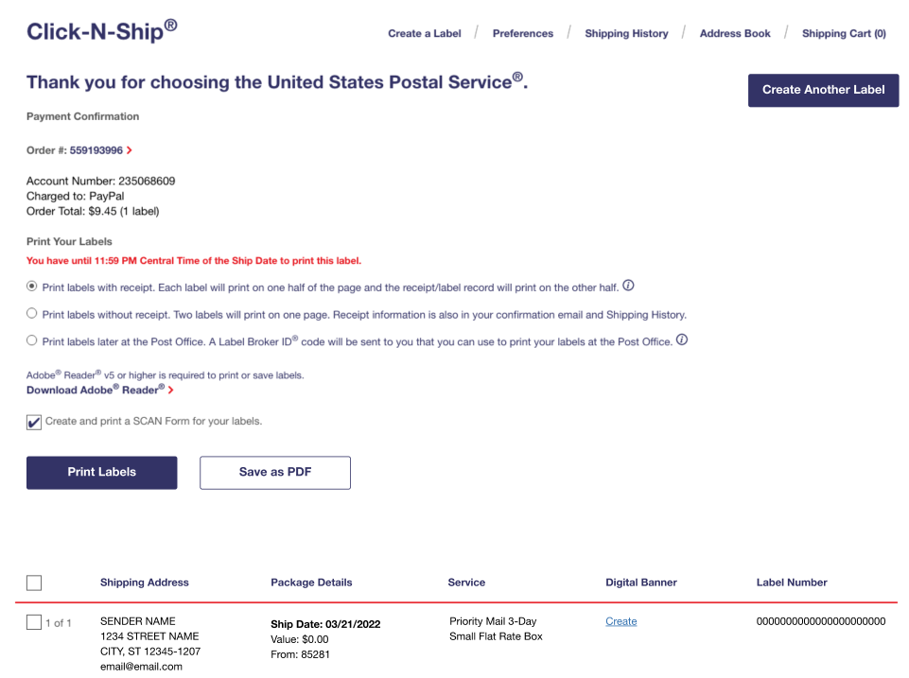
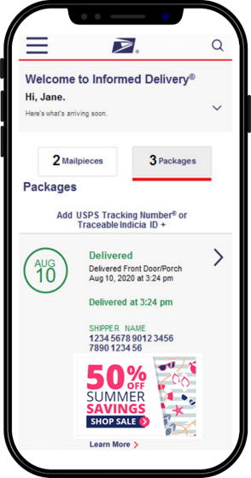
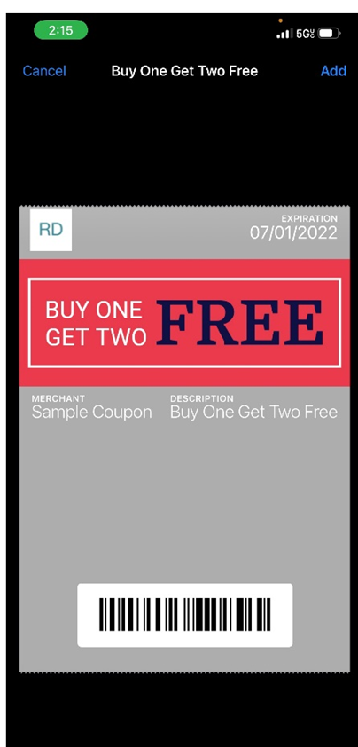
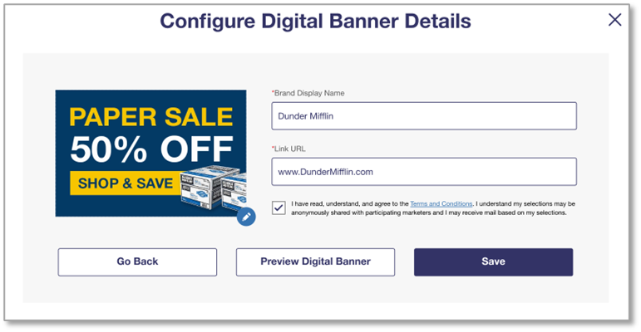
NEW Tools Available with Informed Delivery
Notes:
Informed Delivery has introduced a set of tools to facilitate the creation of content for campaigns. These tools are designed specifically to assist small shippers and mailers with creating marketing content:
Image Library
A library of images that shippers and marketers can download and edit to utilize in the call to action when creating their Informed Delivery campaign.
Coupon Library
A Library of downloadable and editable coupons that shippers and mailers can configure and use both digitally and in print.
Coming Soon: Informed Delivery for Click-n-Ship
USPS Connect business users will be able to create labels and a digital banner
The user provides necessary fields to create the Package Campaign including image, brand name, and URL

Slide 9
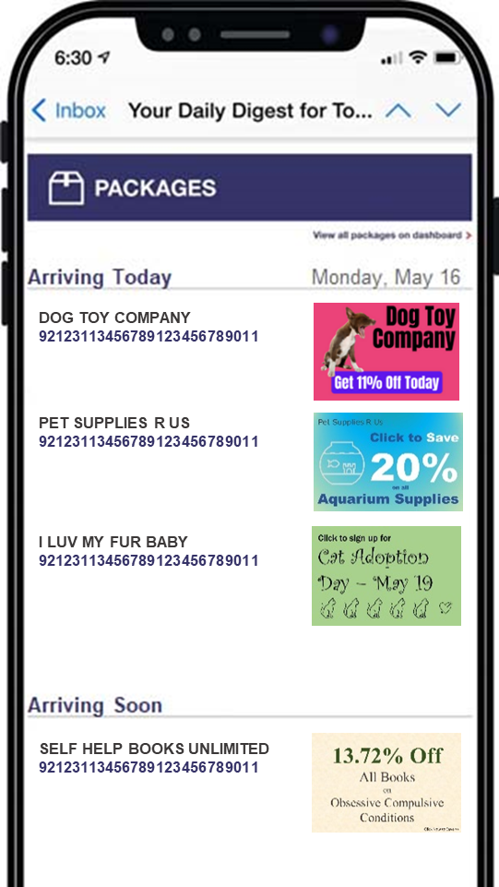
Package campaigns are a new channel for businesses to reach and retarget their existing customers.
Tracking appears on the Informed Delivery dashboard when the package label is created.
Tracking appears in the dashboard for 14 days after delivery.
Tracking appears in the email Daily Digest when an expected delivery date is applied.
Tracking appears in the email Daily Digest up to and including the day of delivery.
Custom images and links provide access to the shipper digital experience.
4.9
billion
packages in Informed Delivery
Notes:
Package campaigns are a new channel for businesses to reach and retarget their existing customers.
They can be created via the Business Customer Gateway or an API.
The Informed Delivery dashboard is visible when the package label is created and for 14 days after delivery.
The Daily Digest email includes the ride along image up to and including the day of delivery.
you click on ride-along image next to package tracking information and then view the call to action and visit your brand’s website.

Slide 10
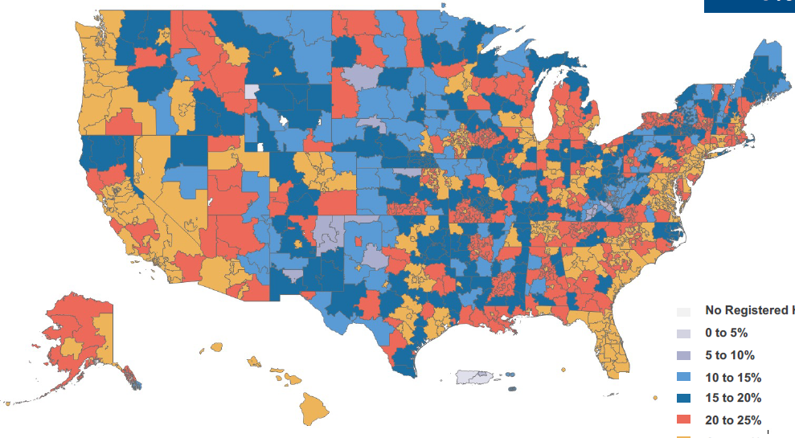
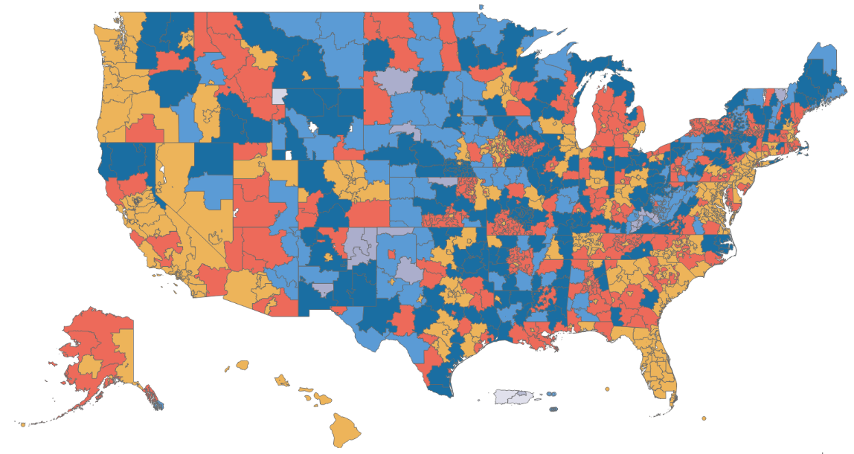
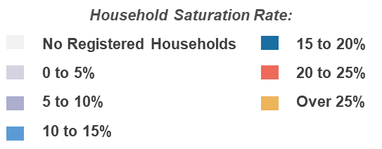
27.8%
National Saturation
National Household Saturation Rate
50.2M
Informed Delivery® Users
42.3M
Informed Delivery® Email Users
36.9M
Households
USPS Internal Data as of September 7, 2022
Notes:
Informed Delivery is reaching more people across the country every day. As of today we have hit over 50 MILLION users nationwide. With an expanded saturation rate at over 27% and an email open rate at 69.8%. Informed Delivery continues to be a valuable asset for marketers and end users alike.

Slide 11
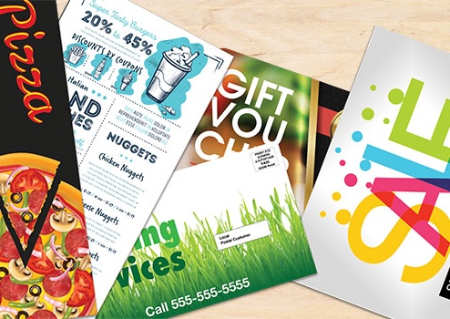
EVERY DOOR DIRECT MAIL®
Reach potential customers with geographic and demographic targeting.
Increase revenue by bringing in new customers and reducing mail preparation costs.
57% of businesses surveyed described services like EDDM as "Very Effective."
Notes:
Every Door Direct Mail, or EDDM, is a USPS service that helps businesses and organizations reach potential customers in their neighborhood.
It's as simple as identifying the delivery routes you want to reach, preparing the mailpiece, and USPS delivering the printed mail to addresses in the specified area.
EDDM's affordable geographic and demographic targeting work; 57% of businesses surveyed described services like EDDM as "Very Effective."

Slide 12
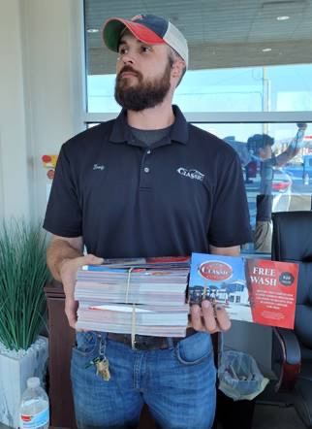
“Plus One”
Amplify messages to the consumer with additional visibility.
Add an addressed Plus One advertising card alongside a “marriage mail” piece, which combines ads from multiple companies into a single mailpiece.
Notes:
Plus One has been in market testing for 2 years. In January of this year 2022, the US Postal Service added Plus One as a permanent product offering to their market mail saturation letters.
The "Plus One" is an addressed advertising card that can be mailed as an add-on piece alongside a “marriage mail” mailpiece. Marriage mail is a form of direct mail “marrying” advertisements from multiple companies into a single mailpiece.
Plus One provides a cost-efficient means of testing the value of a standalone mailpiece for an advertiser.

Slide 13






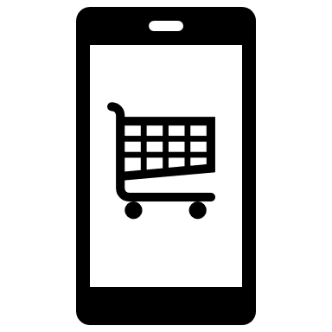





Direct Mail Retargeting
Mail can be hyper-targeted and sent while a brand and products are top of mind.
Marketers saw a 300-400% lift. in conversion rates when targeting cart abandoners specifically.¹
Offer!
Call to Action!
(CTA)
SALE
Digital Interaction
Shopping Cart Abandonment
Direct Mail Piece Sent
In-Store Action, or…
Digital Interaction
65% of marketing respondents reported an increase in website traffic2
47% of marketing respondents reported an increase in conversions
1. Dave Cesaro, “Leveraging Trends in Digital Marketing to Use in Direct Mail,” National Postal Forum, May 8, 2018.
2. USPS; The Future of Direct Mail Is Here and It’s Dynamic
Notes:
Direct Mail Retargeting
In this digital age most all of us are on our phones shopping. Its so easy to put it in the shopping cart. Then we have shoppers' remorse or second thoughts or our husband walks in the room….and we abandon the cart.
Marketers saw a 300 – 400% lift in conversion rates when retargeting cart abandoners. I have been retargeted myself and it absolutely worked on me! DM can be hyper targeted while brand is top of mind.

Slide 14

Boost ROI With Active Promotions.
Notes:
Active Promotions for 2022

Slide 15













USPS Marketing Mail
Marketing Mail and First-Class® Mail Products
First-Class® Mail Service
Registration Period
Promotion Period
PROMOTIONS
DEC
JAN
FEB
MAR
APR
MAY
JUN
JUL
AUG
SEPT
OCT
NOV
DEC
TACTILE, SENSORY AND INTERACTIVE
DEC 15
FEB 1
JUL 31
EMERGING AND ADVANCED TECHNOLOGY
JAN 15
MAR 1
AUG 31
FEB 15 MAR 31
EARNED VALUE
APR 1
JUN 30
PERSONALIZED COLOR TRANSPROMO
MAY 15
JUL 1
DEC 31
MOBILE SHOPPING
JUN 15
AUG 1
DEC 31
INFORMED
DELIVERY®
In Market/Active
MOBILE SHOPPING
**Marketing Mail only
INFORMED DELIVERY®
JUL 15
SEPT 1
DEC 31
Notes:
Currently, we have three active promotions running through the end of the year.

Slide 16
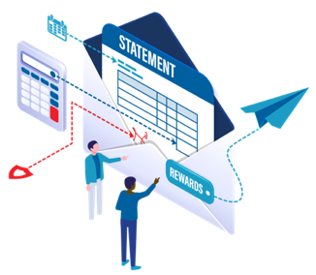
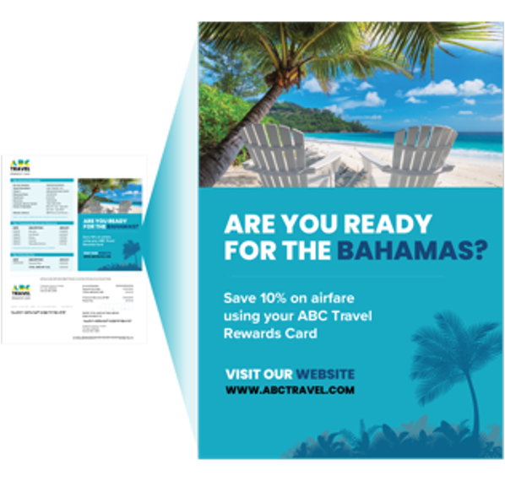
Personalized Color Transpromo
Businesses can incorporate personalized and colorful marketing messages into bills and statements to improve customer engagement and responses.
What’s it for…
First-Class Mail letters
REGISTRATION PERIOD
DISCOUNT AMOUNT
3% off
eligible postage
May 15, 2022
–
Dec 31, 2022
PROMOTION PERIOD
Jul 1, 2022
–
Dec 31, 2022
Notes:
Personalized color Transpromo
It is for 1st class mail
participants need to include a full color marketing message and/or visualization of account data in two or more colors not including black, white, or gray scale.
Previous participants need to meet the personalization requirements.

Slide 17
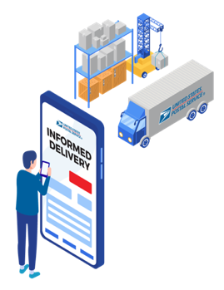
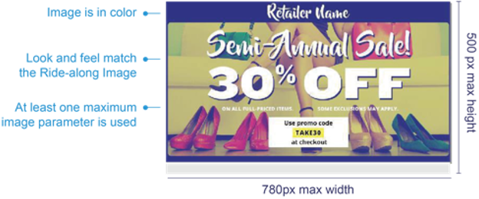
Informed Delivery
The 2022 Informed Delivery promotion encourages business mailers to conduct campaigns that use colorful and interactive elements to enhance and extend the mail moment for consumers, enabling them to reach their target audiences through both mail and digital channels.
What’s it for…
First-Class Mail (Letters, Flats and Postcards) Marketing Mail letters & Flats (Includes Non-Profit)
DISCOUNT AMOUNT
REGISTRATION PERIOD
4% off
eligible postage
Jun 15, 2022
–
Dec 31, 2022
PROMOTION PERIOD
Aug 1, 2022
–
Dec 31, 2022
Notes:
Earlier we discussed the Informed Delivery program, which business mailers can use to create additional consumer impressions and interactions across digital and physical mailboxes.
The 2022 promotion we're running for Informed Delivery offers a 4% discount for using the service and pairing a digital ride-along image and a representative image with your mail campaign.

Slide 18
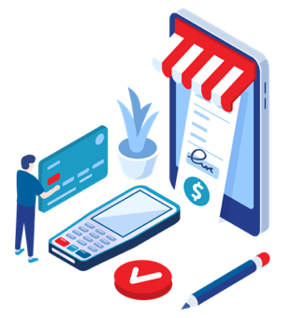

Mobile Shopping
Blend mobile technologies with direct mail to create a convenient, efficient online shopping experience for customers.
What’s it for…
Marketing Mail letters & Flats (Includes Non-Profit)
DISCOUNT AMOUNT
REGISTRATION PERIOD
2% off
eligible postage
Jul 15, 2022
–
Dec 31, 2022
PROMOTION PERIOD
Sept 1, 2022
–
Dec 31, 2022
Notes:
The Mobile Shopping promotion encourages mailers to integrate mobile technologies with direct mail to create a convenient, efficient online shopping experience for customers.

Slide 19
2023 PROPOSED
MAILING
PROMOTIONS
Note: Pending Approval
Notes:
USPS Promotions encourage marketers, printers, and mailers to try out new technology and print techniques to drive higher customer engagement and response rates,
The 2023 promotions I am about to share are proposed pending PRC approval. When they are approved, we will receive an Industry alert as well as it being posted on postalpro.com

Slide 20
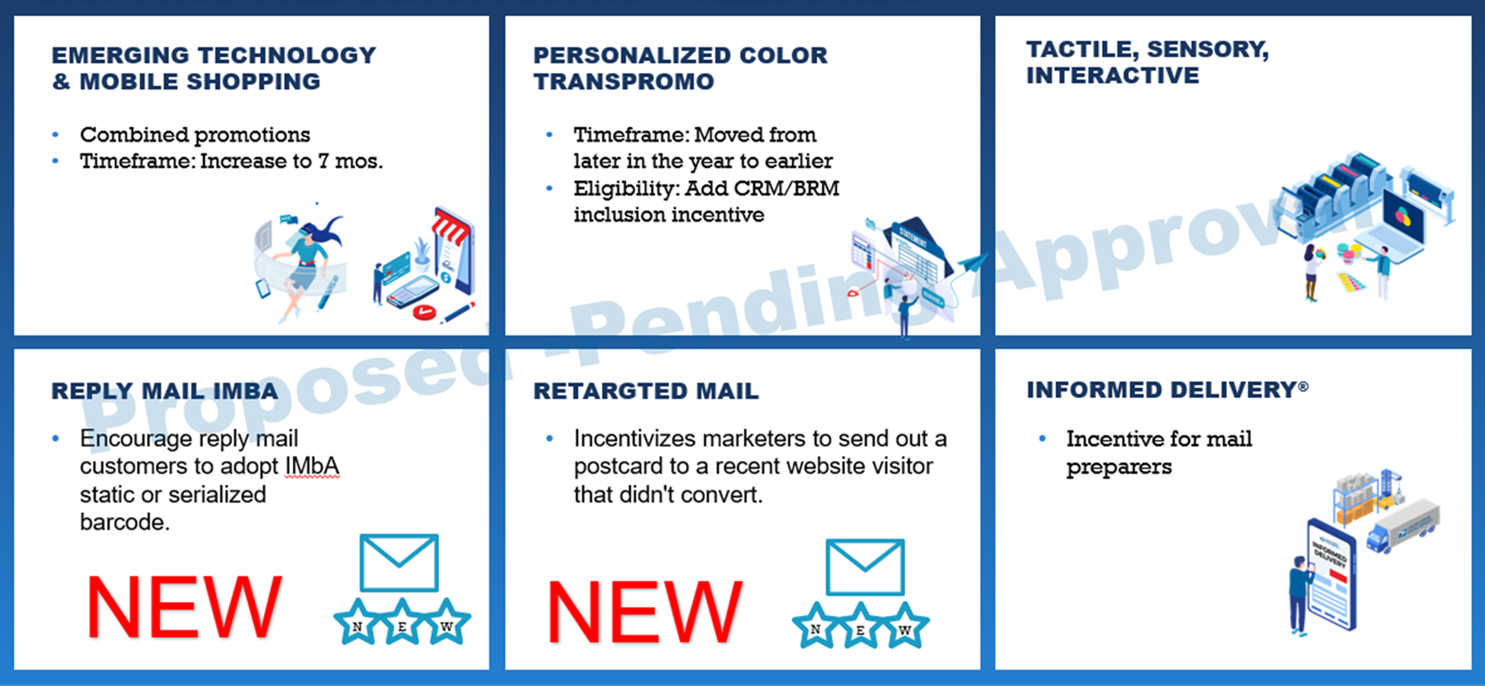
FY23 Proposed Promotions – What’s New
Notes:
So what’s new for 2023? They are still pending approval, but here is a sneak peek at the latest and greatest promotions:
EMERGING TECHNOLOGY & MOBILE SHOPPING
emerging technologies such as Enhanced Augmented Reality, Mixed Reality, Virtual Reality, NFC, Video in Print, and mail integration with voice assistants ELIGIBILITY Marketing Mail letters and flats; First-Class Mail letters, cards, and flats;
PERSONALIZED COLOR TRANSPROMO
Enhances the value of First-Class Mail by encouraging mailers of bills and statements to incorporate color marketing messaging to improve connection to and from customers. Mailers will receive additional X% discount for reply mail inclusion. ELIGIBILITY First-Class Mail presort and automation letters (bills and statements)
TACTILE, SENSORY AND INTERACTIVE
MAILPIECE ENGAGEMENT
Encourages mailers to enhance customer engagement through innovations in paper and stock, substrates, inks, interactive elements, and finishing techniques. ELIGIBILITY Marketing Mail letters and flats; First-Class Mail letters, cards, and flats
REPLY MAIL IMbA
Encourages QBRM and High Volume QBRM customers to adopt IMbA. Participants will need to enroll in IMbA and use either a static or serialized barcode. ELIGIBILITY First-Class Mail QBRM Letters & Cards and High Volume QBRM Letters & Cards
RETARGET MAIL
Incentivizes marketers to send out a personalized postcard to a recent website visitor that didn't convert. ELIGIBILITY First-Class Mail postcards
INFORMED DELIVERY
Encouraging mailers to use the Informed Delivery omni-channel feature.
ELIGIBILITY Qualifying automation Marketing Mail letters and flats; qualifying automation First-Class Mail letters, cards, and flats (saturation flats?)

Slide 21
Proposed 2023 Promotions Calendar
Marketing Mail and First-Class® Mail Products
First-Class® Mail Service
Registration Period
Promotion Period
PROMOTIONS
DEC
JAN
FEB
MAR
APR
MAY
JUN
JUL
AUG
SEPT
OCT
NOV
DEC
TACTILE, SENSORY AND INTERACTIVE
DEC 15
FEB 1
JUL 31
PERSONALIZED COLOR TRANSPROMO
DEC 15
FEB 1
JUL 31
Proposed -Pending Approval
EMERGING TECHNOLOGY & MOBILE SHOPPING
MAR15
MAY 1
NOV 30
Reply Mail IMbA
New
MAY 15
JUL 1
DEC 31
INFORMED DELIVERY
JUN 15
AUG 1
DEC 31
RETARGET
New
JUL 15
SEPT 1
NOV 30
Notes:
This is the proposed promotions calendar for 2023. Again, these are pending approval and when finalized you will be notified by your sales rep and will be posted in postalpro.com and an Industry alert will be sent out as well..

Slide 22

USPSCONNECT
Notes:
The U.S. Postal Service is evolving to better meet the needs of our customers—small and large—and to help businesses thrive. That’s why I am excited to meet with you today and share what we are doing to help your business grow.
We know that you have options when it comes to choosing a shipping carrier. Every time you entrust the U.S. Postal Service to deliver your packages, we take that responsibility seriously. And we greatly appreciate your business.
We also recognize the scope and challenges of your responsibilities when it comes to ensuring that your warehousing, picking, packaging, distribution, and package delivery operations run smoothly in an ever-changing marketplace. Optimizing this nonstop cycle at every step can mean the difference between gaining a customer for life and losing them.
You understand firsthand the need for affordable, convenient, and fast package delivery operations to meet customer demand—because they are your needs.
The Postal Service is the carrier best positioned to meet those needs through the USPS Connect™ suite of services.

Slide 23

What is
?
It’s our new approach to meet the evolving package and mail delivery needs for businesses of all sizes. This suite of affordable solutions capitalizes on our ongoing network improvements, new processing equipment, and increased operational precision.
Notes:
Our commitment to serving the American people remains as steadfast as ever. That’s why USPS Connect is such an important part of our future. USPS Connect capitalizes on our vast physical distribution capabilities to help our business customers meet consumer demand for quick and affordable delivery and returns options in a way that no other carrier can.
Make expected same-day or next-day deliveries throughout your neighborhood with Connect Local.
Expand your reach and start making next-day deliveries to more customers using USPS Connect Regional.
Utilize affordable nationwide package delivery solutions for businesses and organizations of all sizes with the Connect National suite of services.
Satisfy customers with easy returns and get products restocked quickly by taking advantage of the most accessible shipper, the US Postal Service.
What’s different about the USPS Connect program? It gives businesses of all sizes direct access to our unmatched delivery network for affordable same-day and next-day delivery and returns in local, regional, and national markets.

Slide 24

Notes:
USPS Connect™ Local was successfully piloted in select locations and is now being rolled out nationally. This innovative suite of services helps neighborhood businesses and organizations exceed their customers’ expectations with Local-to-Local delivery. With USPS Connect Local, we’re empowering Main Street businesses to compete and win in the global e-commerce world.
However, before we talk about what USPS Connect Local is and how it works, it’s important to understand the trends we’re seeing in the delivery marketplace and why same-day and next-day delivery at a local level is crucial for business growth.

Slide 25
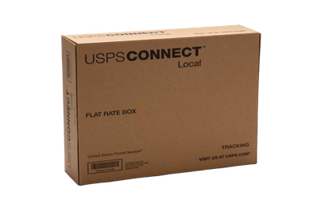
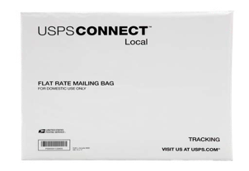
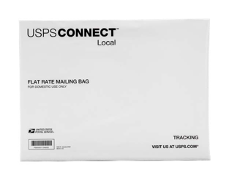
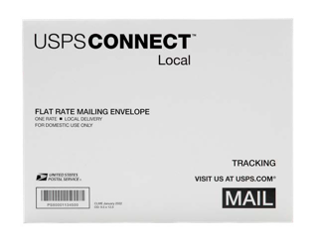
Shipping made easy and convenient.
USPS Connect Local Flat Rate packaging options:
With USPS Connect™ Local, you can select from several flat-rate options or use your own packaging to get rates as low as $3.95 for shipping and $2.95 for mail. Plus, you can get free Package Pickup.¹
Flat Rate Box:
$4.95 for up to
25 pounds
Flat Rate Small Poly Bag:
$4.15 for up to
25 pounds
Flat Rate Large Poly Bag:
$4.95 for up to
25 pounds
Flat Rate and Legal Flat Rate Envelopes:
$2.95 for up to 13 ounces
1. For details on free Package Pickup, visit usps.com/pickup.
Notes:
We know that ease and convenience are priorities for you.
That’s why we are making it simple to order USPS Connect Local Flat Rate boxes and envelopes right through the Click-N-Ship® application—at no charge to you.
And with free Package Pickup, you can spend less time making trips to the Post Office and more time focused on growing your business.

Slide 26
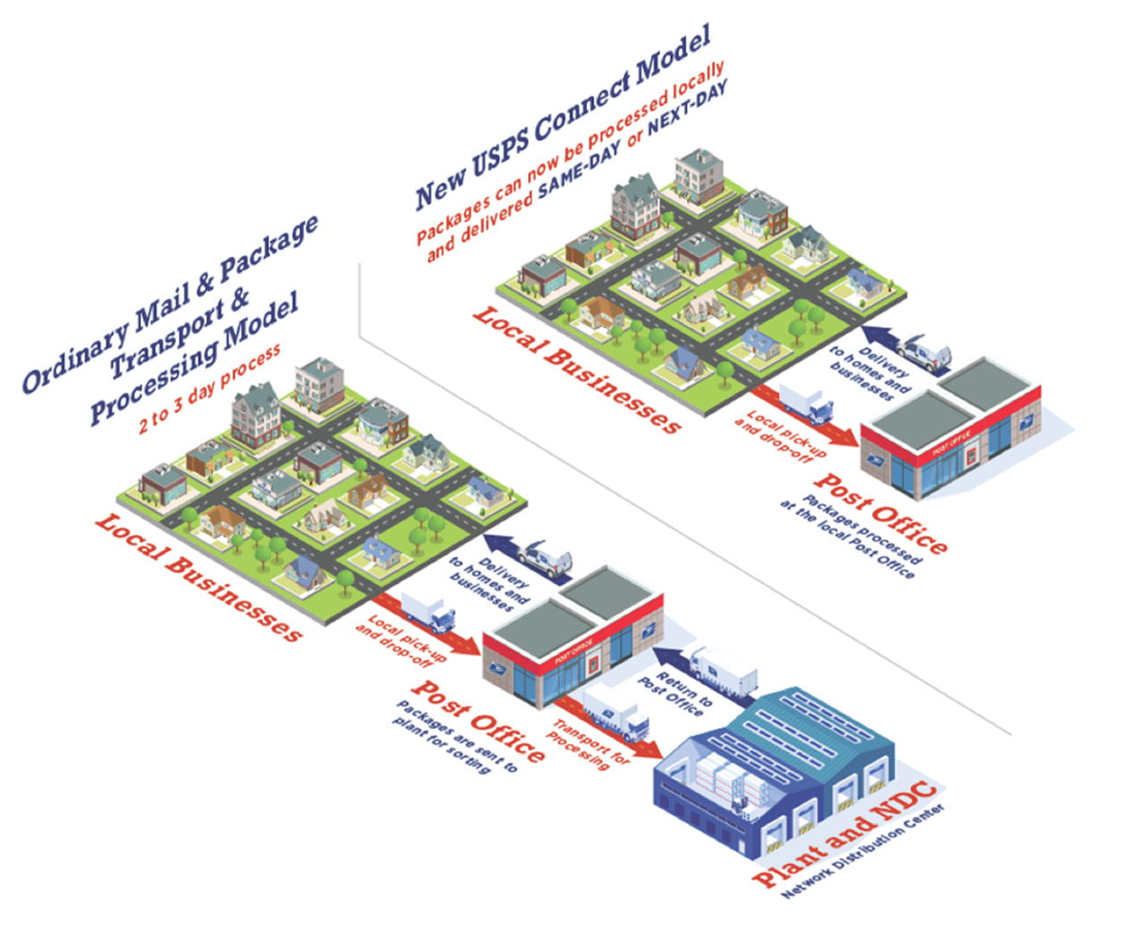
Why USPS Connect™ Local is good for your business.
Meet customer demand.
Provides new,
cost-effective ways to meet customer demand for
fast delivery.
Fast delivery.
Offers expected same-day or next- day package and mail delivery.¹
Convenient pickup.
Provides free Package Pickup, available for next- day delivery.²
Cost savings.
Flat-rate shipping
and mailing supplies are available at no additional cost³ when you print and pay for postage via the Click- N-Ship® application.
Added value.
Qualified customers could be featured in our USPS® Shipping Local Directory on USPS.com.⁴
Participation in USPS Connect Local requires agreement to program terms and entry of packages and mail close to final destination. Same-day delivery is expected but not guaranteed and may not be available at all locations. Next-day delivery may be impacted by holidays and availability of Sunday delivery. When Sunday delivery is available, there is an additional fee for USPS Connect Local Shipping services. Sunday delivery is not available for USPS Connect Local Mail services. Additional restrictions may apply. Speak with your USPS® Representative for details.
For details on free Package Pickup, visit usps.com/pickup. On-demand pickup is available for a fee and is not available for the USPS Connect Local flat-rate mail service.
Free packaging is only available for Flat Rate boxes, bags, and envelopes.
Please visit usps.com/business/shipping-local-directory-criteria.htm for details and eligibility requirements.
Notes:
With consumers shopping online more than ever, businesses need to find new, cost-effective ways to compete on speed, price, and convenience to meet customer demand for local delivery. USPS is ready to help businesses like yours meet these challenges head-on to increase local sales. That’s why we are introducing USPS Connect Local.
USPS Connect Local offers expected same-day or next-day delivery to your local customers who are located within the same ZIP Code™ areas served by participating U.S. Postal Service® facilities.
To help you save even more, USPS Connect Local shipping and mailing supplies are available at no additional cost when you print and pay for postage via the Click-N-Ship application.
The suite of USPS Connect Local services is great for businesses across all industries and nonprofits that need to deliver to their local community. For example:
A neighborhood pharmacy that needs to deliver time-sensitive medications to patients.
A family-owned pet store that wants to ensure that dog food and treats arrive fresh to local customers.
A neighborhood candy shop that wants to send holiday gifts from their customers to local recipients.
A school that needs to deliver items ordered for a fundraiser.
A law firm that needs to deliver time-sensitive documents to a local client.
USPS Connect Local offers your business:
Convenience. USPS Connect Local makes same-day or next-day delivery simple. Just bring your items to your local participating Post Office™ location.
Value. Competitively priced services provide value for your business and your customers, enabling potential savings over other carriers or your own delivery people. Plus, qualified customers could be featured in our USPS Shipping Local Directory on USPS.com. For more information on the directory, please visit usps.com/business/shipping-local-directory-criteria.htm.
Additional services. USPS provides services beyond your local delivery needs. You can use Priority Mail® service or First-Class Package Service®, or even enter your items for delivery at a regional facility to reach customers who are farther away.

Slide 27
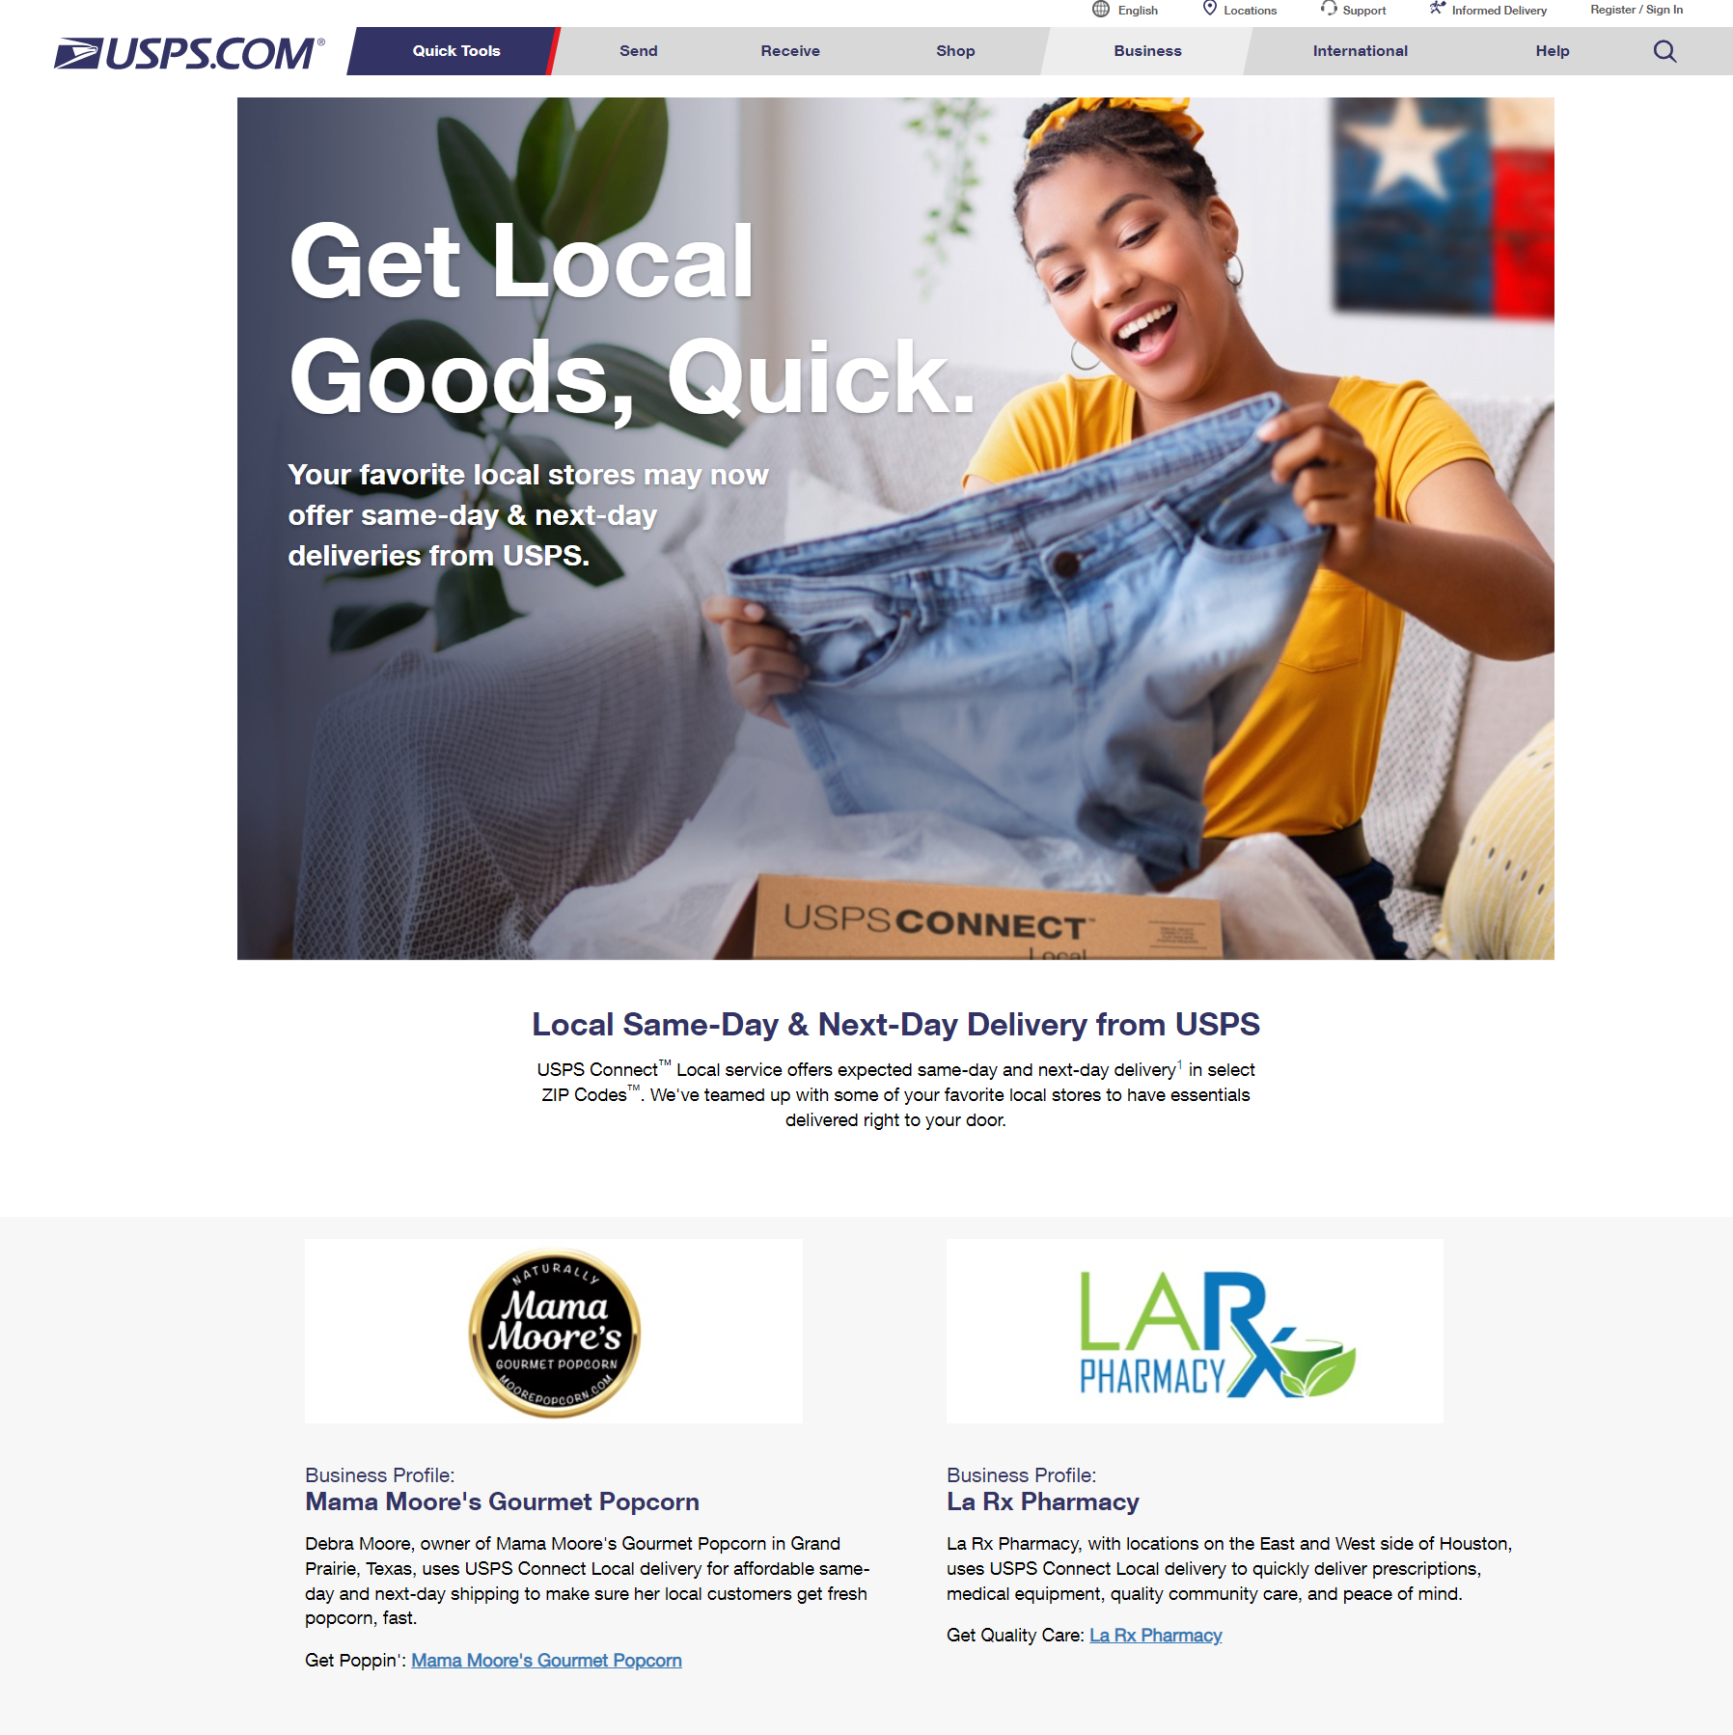
USPS Shipping Connect Local Directory Program – Displaying your Brand Logo
Our Connect Local Directory¹ is a listing of small businesses that ship locally and who are enrolled in the USPS Connect™ Local program that can be listed on our consumer-facing web page on USPS.com®.
Combining your brand with our USPS brand which is considered the most trusted brand in America².
There’s power in combining strong and trusted brands.
  Ask us about our Informed Delivery® ³.
Link to your website.
Free.
The program is currently available in select ZIP Codes™
Morning Consult – Most Trusted Brands 2020
That’s free too!
Notes:
Speaking of branding…once you are enrolled and started shipping with USPS Connect there’s an opportunity for you to join our brand and our valued customer brands in displaying your business logo along with a link to your website as a complimentary service just for being our customer.
The Postal Service is considered the most trusted brand in America as reported by Morning Consult. There’s power in numbers along with the company you associate with.
Most trusted brands: https://morningconsult.com/most-trusted-brands/?mod=djemCMOToday
USPS 42.0%
Amazon 38.8%
Google 37.9%
PayPal 36.5%
The Weather Channel 36.3%
Chick-fil-A 36.2%
Hershey 36.1%
UPS 36.1%
Cheerios 35.9%
M&M 34.8%
https://www.usps.com/business/shipping-local-directory-criteria.htm?_gl=1*17wtk6a*_ga*OTkyMDM5ODgwLjE2NTA0ODc1Mjc.*_ga_3NXP3C8S9V*MTY1MDQ4NzUyNC4xLjEuMTY1MDQ4OTQ3Ni4w&_ga=2.194763373.1977108528.1650487527-992039880.1650487527
https://www.usps.com/business/connect-local-consumers.htm

Slide 28
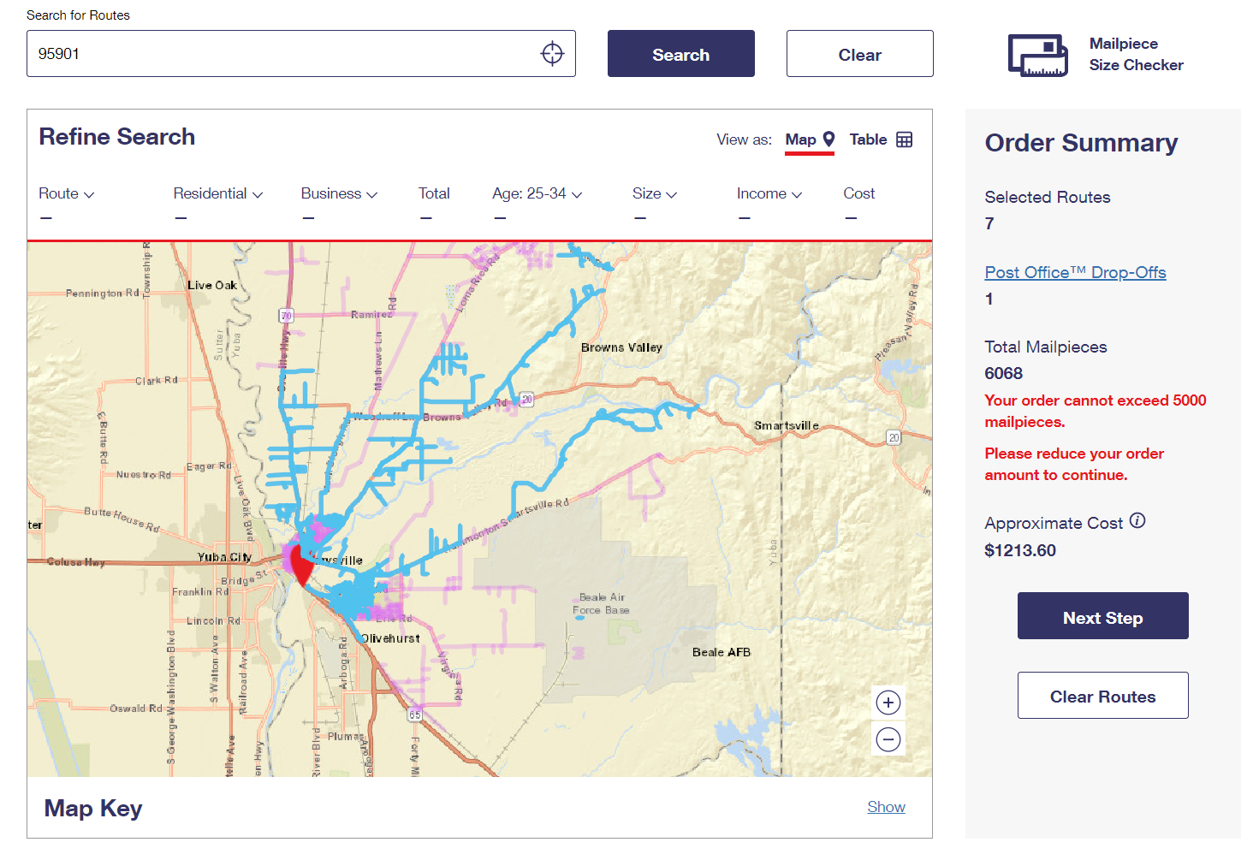
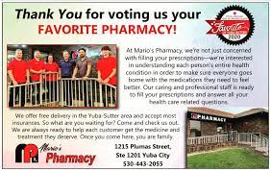
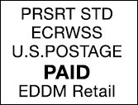
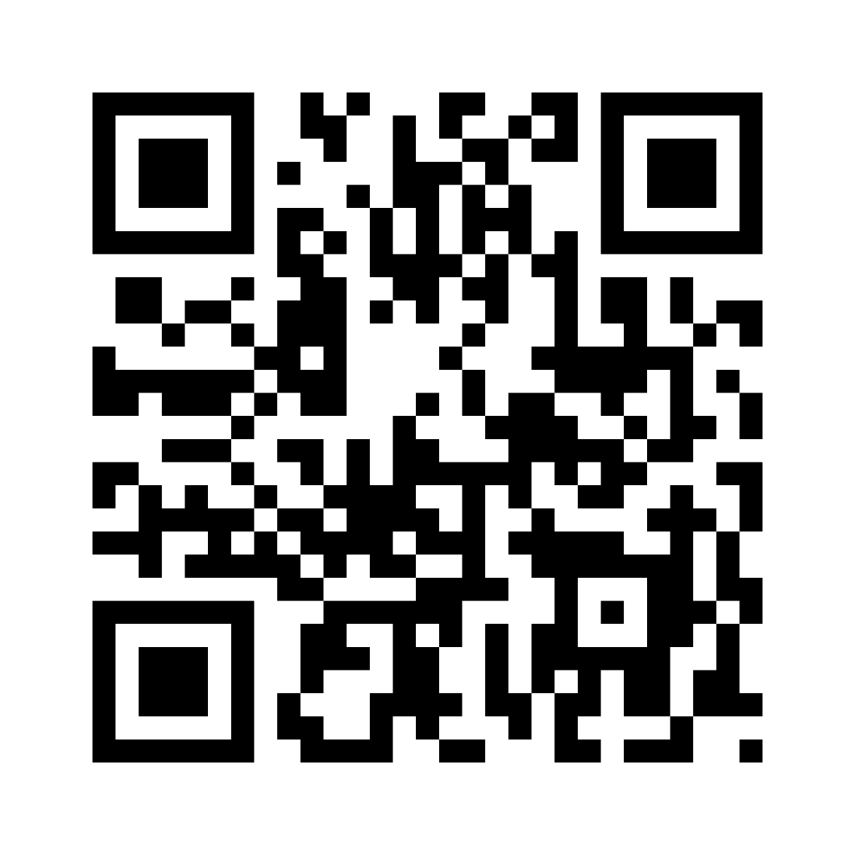
Boosting Connect Local with Every Door Direct Mail
Connect Local will be nationwide in October 2022.
Leverage the low cost of EDDM to help your customers take advantage of the low costs with the Connect suite of products.
Now offering free Next Day delivery on all orders!
Scan to sign up for rewards
*********ECRWSS*******
Local Postal Customer
Notes:
Marrying direct mail with our new Connect solution is an easy and affordable way to let your customers know about the new service available to them. The EDDM online tool is a convenient resource to allow you to select routes within a geographical area to target with a customized mail piece. The more people are aware of the offering within their area, the more likely they are to order from a business participating in Connect Local.

Slide 29
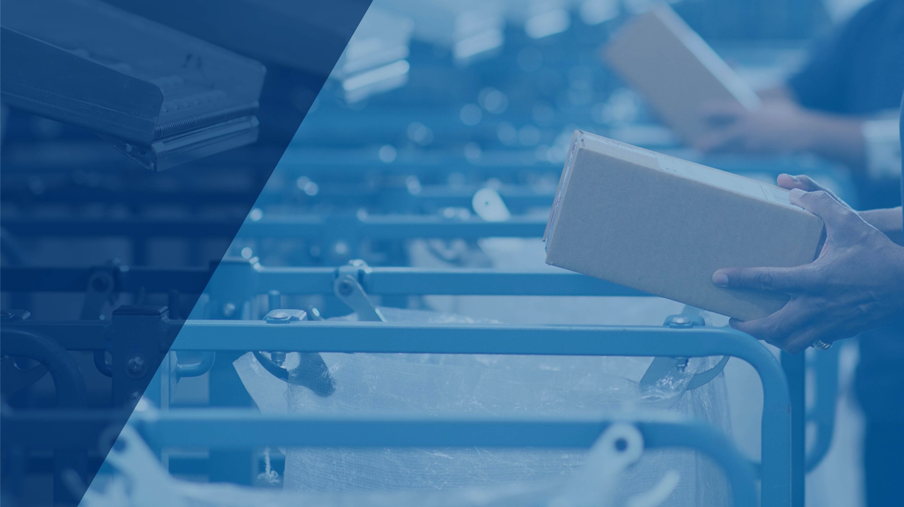
Notes:
USPS Connect™ Regional gives shippers who need expanded geographical reach direct access to our unparalleled network of distribution centers for next-day delivery.
Whether you are a business whose customers are located in a single state or region or you have inventory positioned across the country near your customer base, we have a delivery solution for you. With 200-plus distribution centers across the country, we have unrivaled package sortation and delivery capabilities to meet your needs.

Slide 30
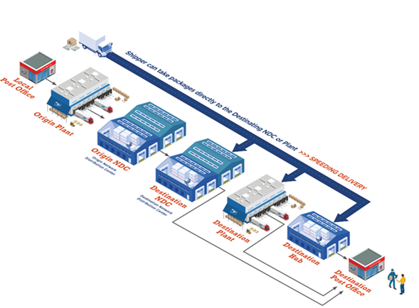
Why USPS Connect™ Regional is good for your business.
Extensive next-day reach.
Fast next-day delivery service¹ six days a week to help you meet
customer demand for fast service.
Unmatched value.
Competitively priced Parcel Select® and Parcel Select Lightweight® shipping services.
Less stops, more reach
Just process packages to the 3-digit ZIP Code™ for entry at the Regional facility.
Participation in USPS Connect Local requires agreement to program terms and entry of packages and mail close to final destination. Same-day delivery is expected but not guaranteed and may not be available at all locations. Next-day delivery may be impacted by holidays and availability of Sunday delivery. When Sunday delivery is available, there is an additional fee for USPS Connect Local Shipping services. Sunday delivery is not available for USPS Connect Local Mail services. Additional restrictions may apply. Speak with your USPS® Representative for details.
For details on free Package Pickup, visit usps.com/pickup. On-demand pickup is available for a fee and is not available for the USPS Connect Local flat-rate mail service.
Free packaging is only available for Flat Rate boxes, bags, and envelopes.
Please visit usps.com/business/shipping-local-directory-criteria.htm for details and eligibility requirements.
Notes:
USPS Connect Regional empowers your business by delivering your packages to your customers the next day when you submit them to USPS facilities closest to their final destination. This process creates the efficiency you need to give your customers what they want—fast, affordable, and reliable delivery.
With USPS Connect Regional, you get real shipping advantages with:
Fast delivery. Enter your shipments at the USPS facility closest to their final delivery destination and get expected next-day delivery.
Affordable expedited ground delivery. Get expected next-day delivery based on 100% ground shipments through USPS Parcel Select and Parcel Select Lightweight services, helping reduce shipping costs.
A vast transportation network. From carrier routes in neighborhoods to transportation connecting our regional facilities and our unparalleled national reach, our vast transportation network means your customer orders are delivered fast.
Security and mailbox access. Your packages are protected by more than 200 federal laws enforced by the United States Postal Inspection Service. And no other shipping carrier can give you delivery access directly into the mailbox of your customers—especially important for high-value and sensitive items.

Slide 31
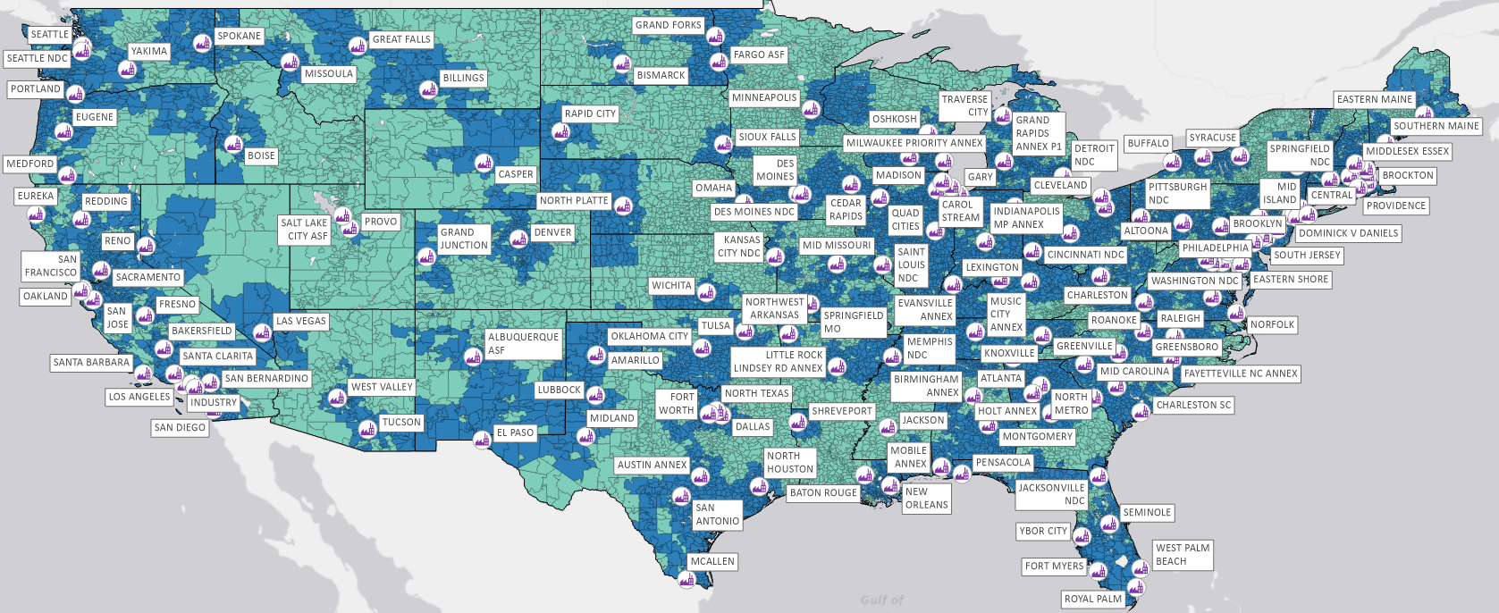
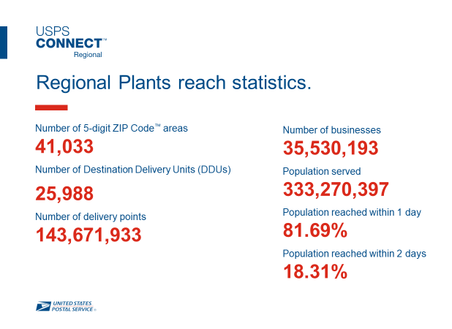

Reach more than 80% of the U.S. population by the next day through our network of regional plants nationwide.
SCF Reach
1-day reach
2-day reach

Slide 32
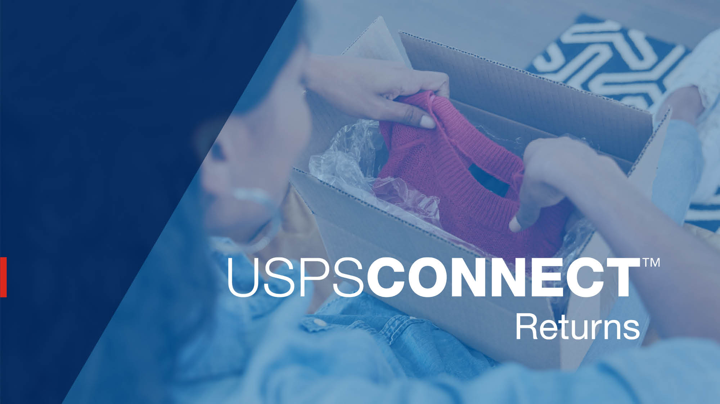
Notes:
Offering a simple, frictionless returns process that meets customer expectations is key to driving repeat sales, building loyalty, and promoting advocacy.
To set your business apart from competitors, you need to put customers first when it comes to returns.

Slide 33

Seamless returns—
just outside your customers’ doors.
97%
of customers agree that the way retailers handle returns influences whether they will purchase from that retailer in the future.¹
“Voxware Returns Survey: Retailer Mistakes Lead to Costly Returns,” Voxware, December 21, 2020.
For details on free Package Pickup, visit usps.com/pickup.
Simple and efficient.
A variety of label options.
Convenient drop-off locations and free Package Pickup.²
Delivering for America plan enhancements for faster returns.
Notes:
USPS Connect™ Returns is enhanced by recent investments and improvements under the Delivering for America plan.
This means that you can now connect your customers to a service that’s just outside their doors. With faster delivery, automated pricing, and a variety of label options to meet your needs, USPS Connect Returns gives you control over an often-neglected part of the buyer journey.
Returns are now easier than ever. Your customers get greater flexibility, ease, and convenience with the option to drop off their returns or schedule a pickup.

Slide 34
Flexible options to meet your needs.
Ground Return Service
When value is more important than speed, for packages up to 70 pounds.
First-Class Package Return® Service
Quick return of lightweight items up to 15.999 ounces.
Parcel Return Service
For high-volume shippers with packages up to 70 pounds.
Priority Mail Return® Service
For time-sensitive or high-value packages up to 70 pounds.
Convenient access: Free Package Pickup.¹ Drop off at 31,000-plus Post Office™ locations and 154,000-plus collection boxes.²
Visibility and data: Scanning and tracking provides detailed package location
to help with inventory management of returned items.
For details on free Package Pickup, visit usps.com/pickup.
Packages must be less than one-half-inch thick and weigh less than 10 ounces to fit in a collection box.
Notes:
Ground Return Service. A great returns option for shippers when value is more important than speed.
First-Class Package Return Service. A smart way for shippers to quickly receive lightweight (under one pound) merchandise.
Parcel Return Service. A dedicated returns service for shippers with a high volume of returns. Work-share discounts are available for consolidating packages for pickup from a Return Delivery Unit or a Return Sectional Center Facility.
Priority Mail Return Service. Offers a combination of speed and value that is ideal for time-sensitive or high-value items.

Slide 35
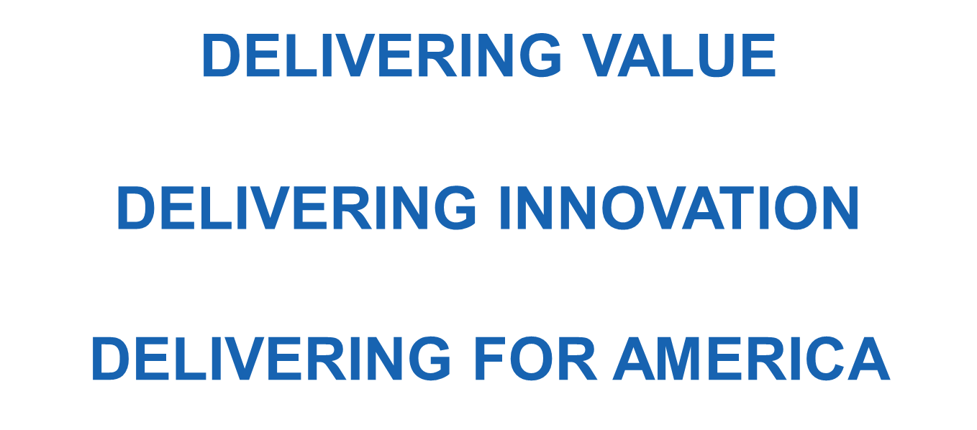
We’re ready to serve you.
At USPS, we’re continuously innovating to keep pace with customer expectations as they grow and change. So expect even more exciting changes ahead as we implement our Delivering for America plan.
Notes:
Whether it’s our current products and services or our new suite of USPS Connect™ solutions, your local Postmasters and USPS® Sales Executives have the expertise to help you choose the right tools to drive growth. And we never stop innovating to keep pace with your expectations.
Expectations are higher than ever for fast and reliable delivery service. That’s why USPS Connect is the right solution at the right time. And this is just the beginning as we continue to Deliver for America.
Together, we can enhance local, regional, and national commerce and make our communities stronger than ever before.

