Slide 1
St. Louis PCC
Darrin Gadson
District Customer Relations Mgr.
USPS Points of Contact
MARCH 8, 2023
This Photo by Unknown Author is licensed under CC BY-NC-ND

Slide 2
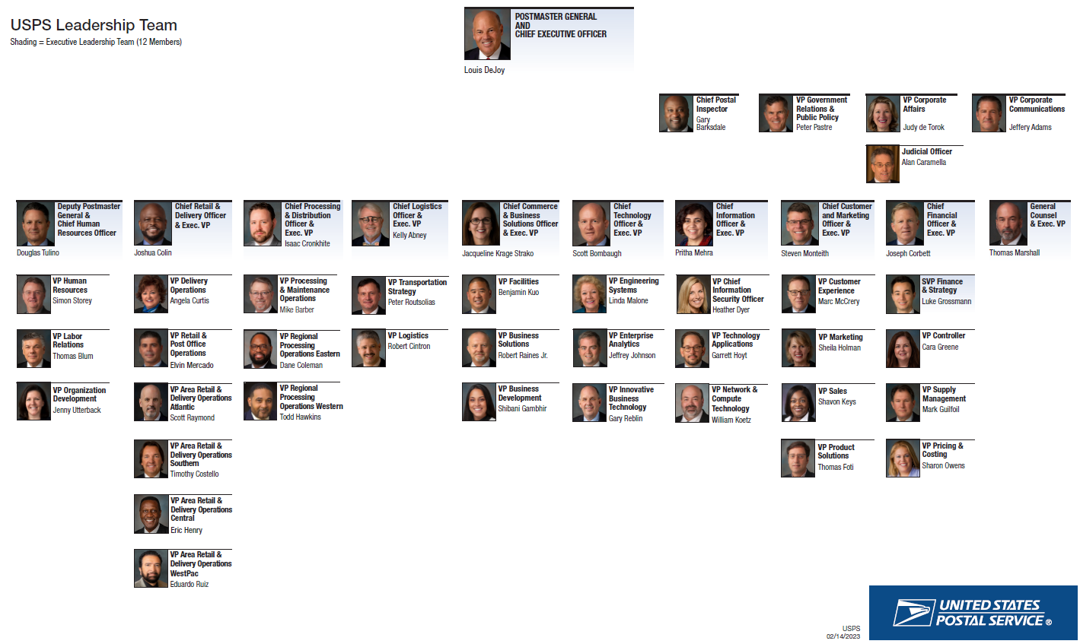

Slide 3
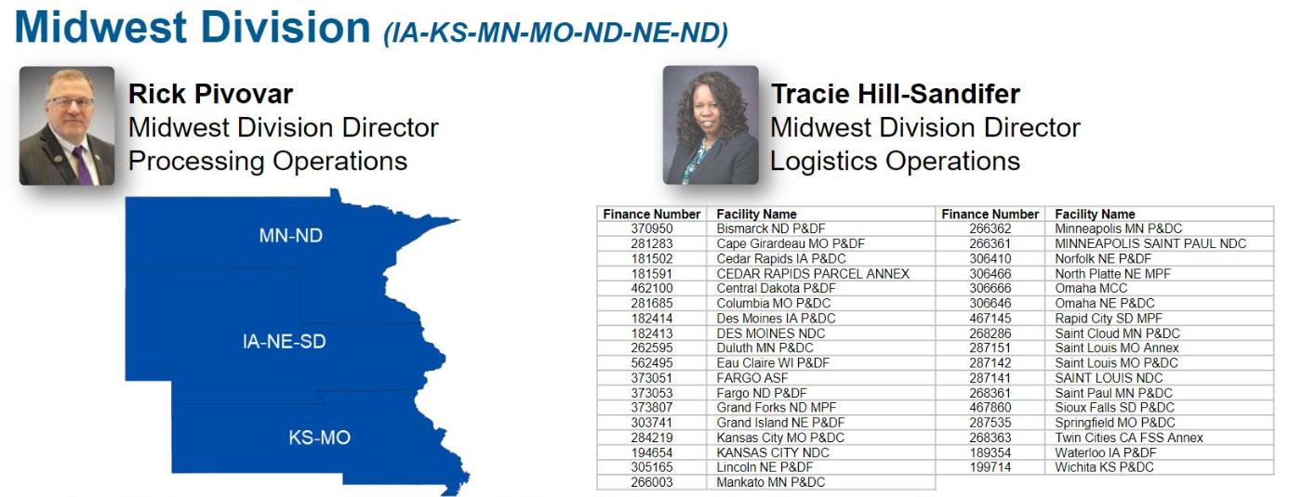

Slide 4
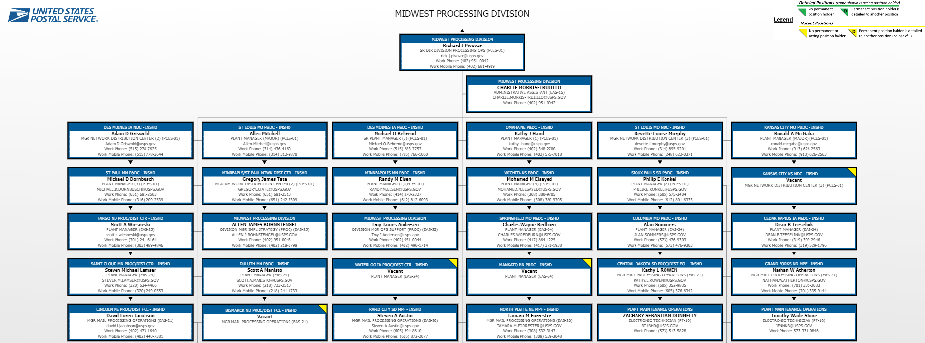

Slide 5
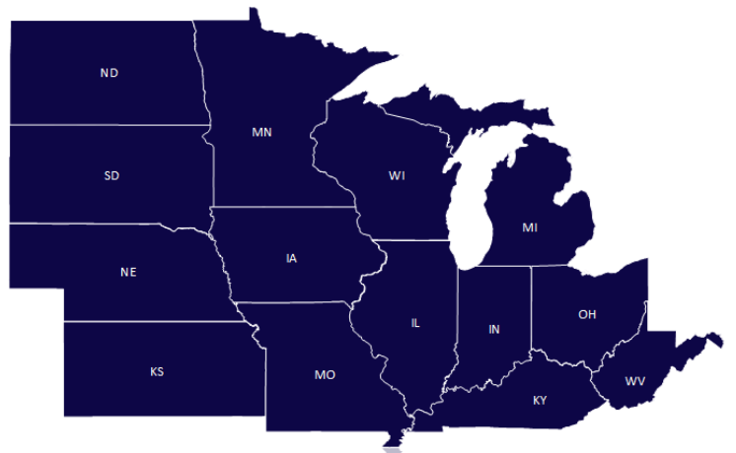
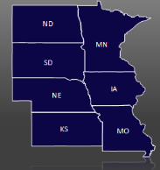
Central Region
Midwest Division

Slide 6
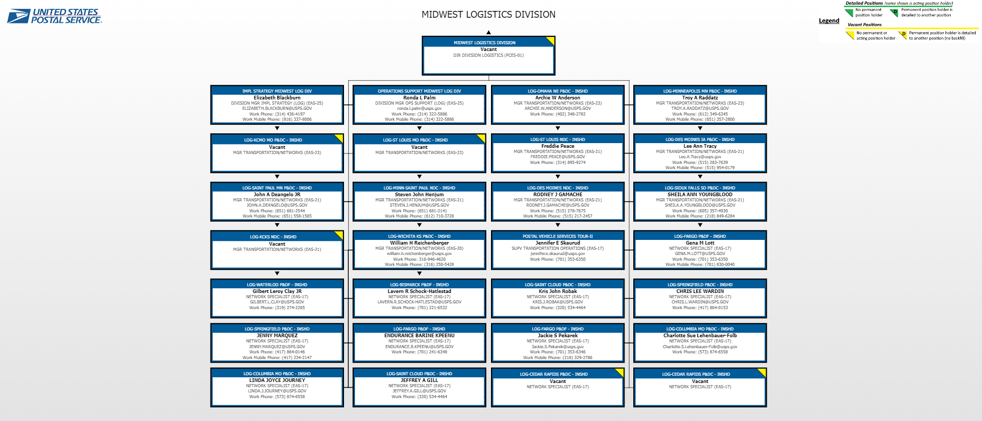

Slide 7
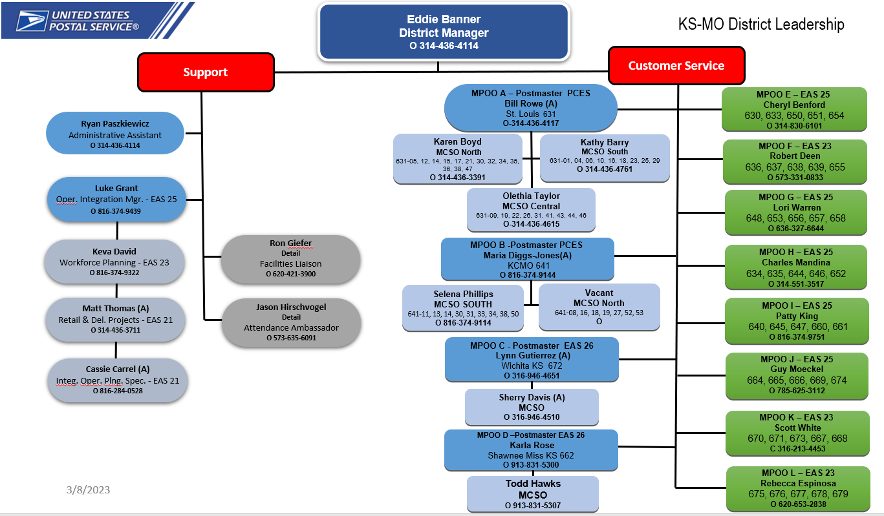

Slide 8
KS-MO District Customer Relations Department’s Contacts
Business Service Network (BSN) – 3 Reps - bsnglks-mo@usps.gov
Cynthia Wagner, KS-MO Consumer Affairs Mgr. (816) 374-9132
Consumer Affairs – 9 CA Reps – ksmoconsumeraffairsdepartment@usps.gov
Business Lead Development Specialist (BLDS) – Anthony Bell (816) 374-9209
Business Mail Entry (BME) – Johnnie Jones, MGR (314) 436-4173
KS-MO Customer Relations Coordinators (CRC) - Keri Beutel (STL)
Customer Relations Specialist (CRS) – Estelle Bell – “Mini Me” – (314) 436-3395

Slide 9
St. Louis Leadership Team Points of Contact
Allen Mitchell – Plant Mgr. St. Louis Processing & Distribution Center (314) 436-4160
Scott Wiesneski – Lead Senior Manager Disputation Operations (314) 345-2957
Shante Blackmore – Logistics/Transportation (314) 436-4324
Andre Meriweather – In Plant Support Mgr. (314) 436-4438
Jessica Tennon – Business Mail Entry Supervisor (314) 436-4178
MTE/MTEOR & Dispatch – (314) 436 -3389 & (314) 436-5538 (314) 436-3996
Additional USPC POCs
Roland Tidmore – Mgr. Operations SFS– (816) 545-1118 and Stamps (816) 5451021
Randy Hite – Area Sr. Business Service Network Rep
Mailing Shipping Solution Center (MSSC) mssc@usps.gov

Slide 10

  Contact your Manager of Customer Relations
Darrin Gadson
KS-MO District Customer Relations Mgr.
(816) 374-9170
Darrin.R.Gadson@USPS.gov

